Slide 1
President
Club Officer Training

Slide 2
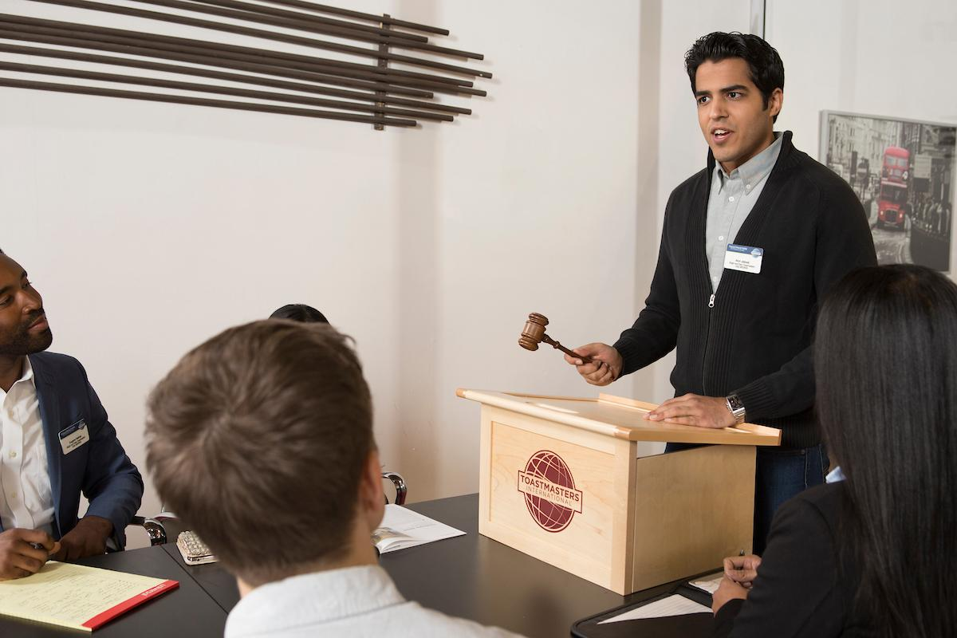


Agenda
President Role
President Responsibilities
President Resources

Slide 3

Session Objectives
Identify your role
Fulfill your responsibilities
Find resources that help you

Slide 4

President Role

Slide 5


President Responsibilities
The Club Meeting
Outside the Club Meeting
The Executive Committee

Slide 6
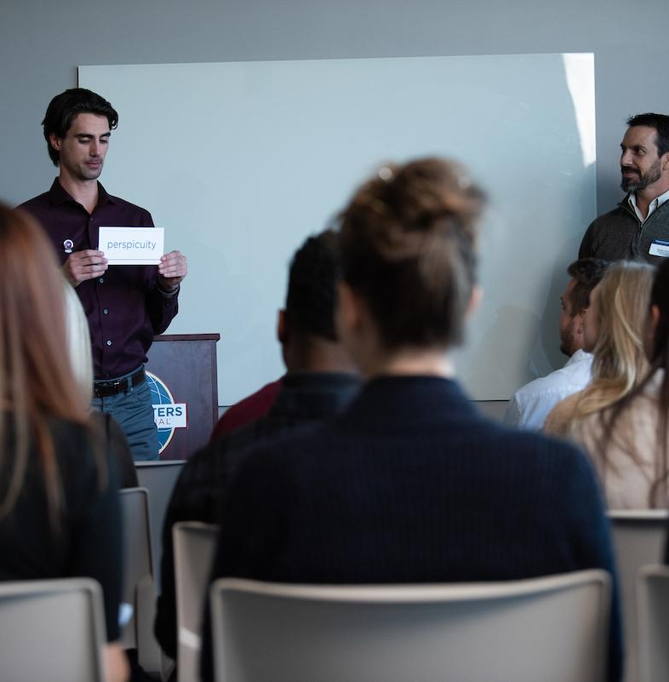
The Club Meeting
Before Club Meetings
Upon Arrival at Club Meetings
During Club Meetings

Slide 7

Before Club Meetings
Ask VPE about special recognition or member inductions.
Plan the business portion of the meeting.
Review parliamentary procedure.

Slide 8
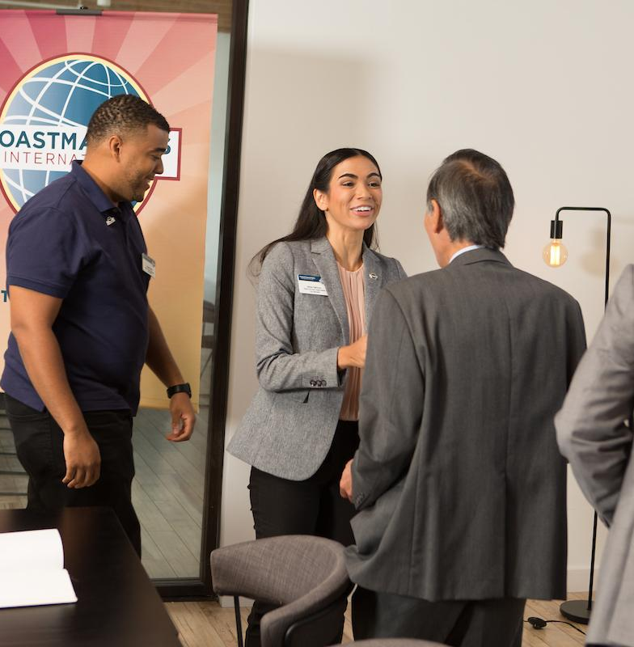
Upon Arrival at Club Meetings
Review the meeting agenda.
Greet guests and members.

Slide 9

During Club Meetings
Call the meeting to order.
Introduce guests.
Explain the meeting’s events.
Conduct the business portion
of the meeting.
Provide information for next meeting.

Slide 10
During Club Meetings
Make any announcements.
Adjourn the meeting.

Slide 11

Outside the Club Meeting
Attend and vote at council meetings.
Attend and vote at the Annual
Business Meeting or Appoint a Proxy to attend on Club’s behalf
Appoint the audit committee.
Appoint the nominating committee.

Slide 12
Outside the Club Meeting
Receive official correspondence from World Headquarters.
Schedule and chair executive committee meetings.
Develop and improve club leadership.
Oversee Club administration.

Slide 13
Outside the Club Meeting
Advance club and member achievement.
Interact effectively with other organization levels.

Slide 14
The Executive Committee
Oversee the executive committee.
Ensure the executive committee
completes its duties

Slide 15

Executive Committee Duties
Create a club budget.
Complete a Club Success Plan.
Strategize for success in the Distinguished Club Program.
Create and oversee other club committees as necessary.

Slide 16

How to Fulfill the President Responsibilities
How
When
Who
What

Slide 17
President Responsibility Action Plan
How will you fulfill this responsibility?
When will each action be completed?
Who is available to help you?
What materials and resources can you use?

Slide 18
President Resources

Slide 19

Getting Started
Attend district -sponsored club -officer training program.
Read materials.
Meet with outgoing executive committee.
Meet with outgoing president.
Meet with current executive committee.

Slide 20
Additional Resources
Club Leadership Handbook - www.toastmasters.org/resources/club-leadership-handbook
Chairman (Item 200) www.toastmasters.org/200
Club Constitution for Clubs of Toastmasters International www.toastmasters.org/policies
Distinguished Club Program and Club Success Plan (Item 1111) www.toastmasters.org/1111
Distinguished Club Program Goals (Item 1111C) www.toastmasters.org/1111C
Speechcraft information www.toastmasters.org/speechcraft

Slide 21
Questions?

Slide 22
All The Best!

