Slide 1
Sergeant-At-Arms (SAA)
Club Officer Training

Slide 2
In any organisation, there’s someone whose job is to grab everything that falls through the cracks

Slide 3
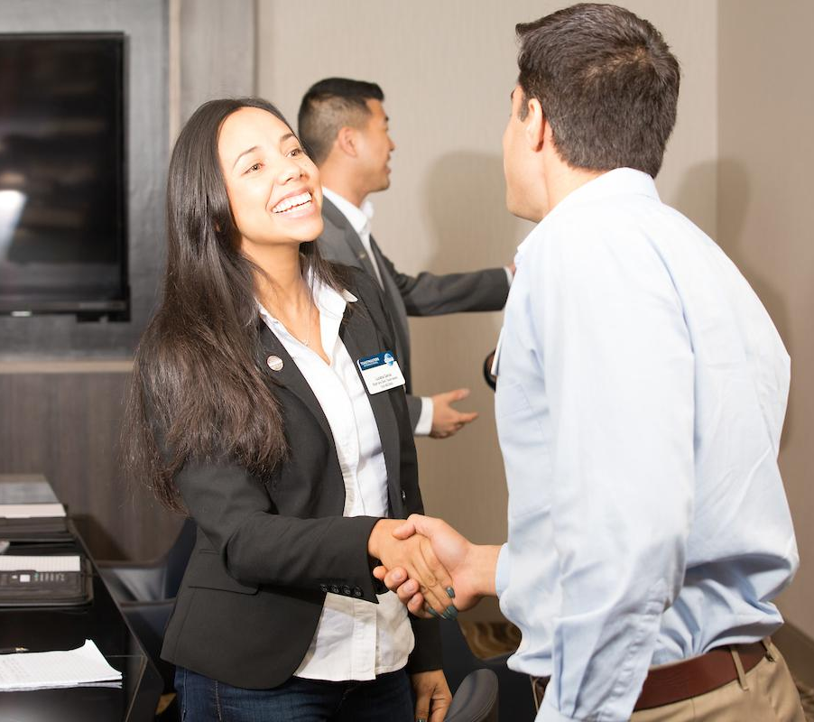

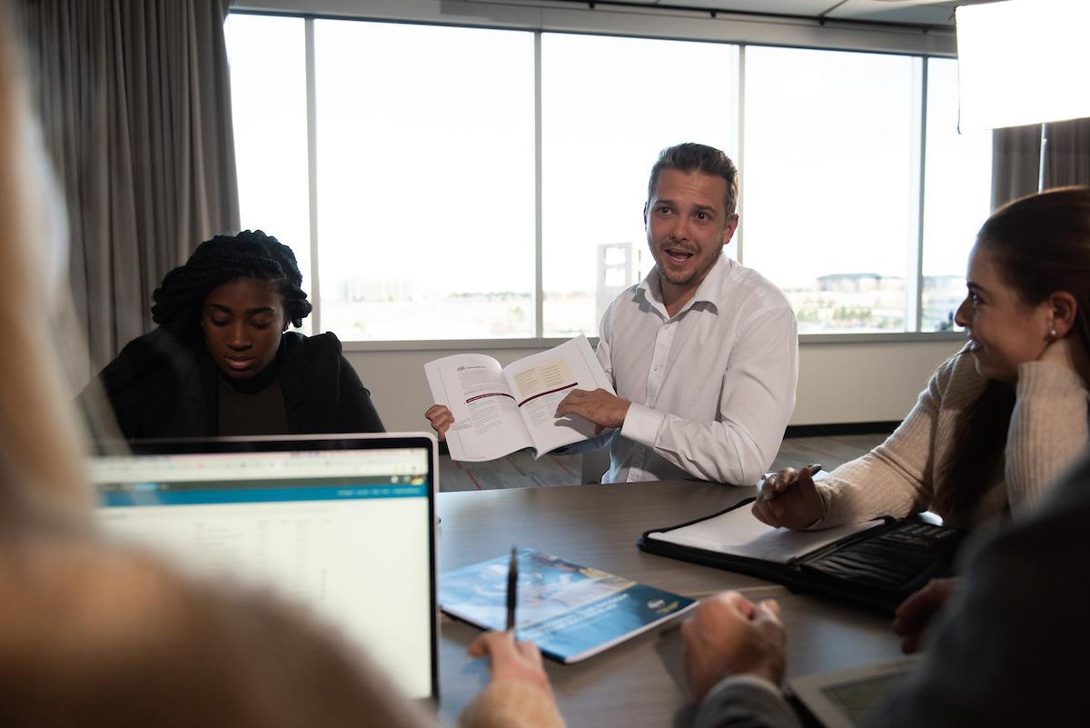
Agenda
SAA Role
SAA Responsibilities
SAA Resources

Slide 4

Session Objectives
Identify your role
Fulfill your responsibilities
Find resources that help you

Slide 5

SAA Role

Slide 6
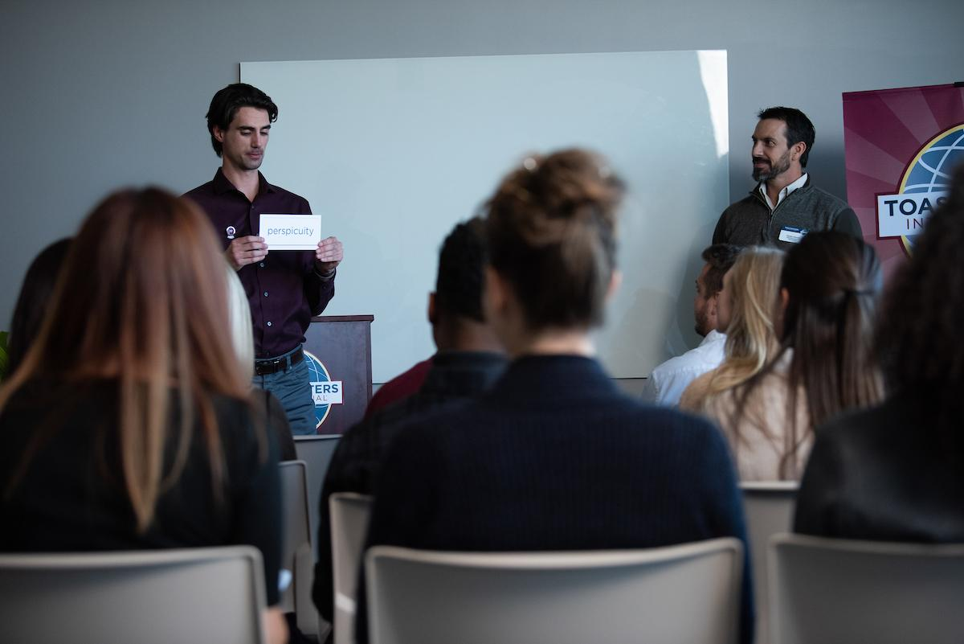
The SAA Role
Keep track of the club’s physical property, such as the banner, lectern, timing device, and other meeting materials
Arrive early to prepare the meeting place for members & guests
Stay late to stow all of the club’s equipment
In-charge of the meeting place itself, obtaining a new space when necessary
Maintain contact with the people who allow you to use the space for your club meetings

Slide 7


SAA Responsibilities
The Club Meeting
Outside the Club Meeting
The Executive Committee

Slide 8
The Club Meeting
Before Club Meetings
Upon Arrival at Club Meetings
During Club Meetings

Slide 9

Before Club Meetings
Confirm room reservation
Ensure there are club supplies
Keep the club’s banner, gavel, lectern, award ribbons, supplies, and other equipment safe and secure

Slide 10
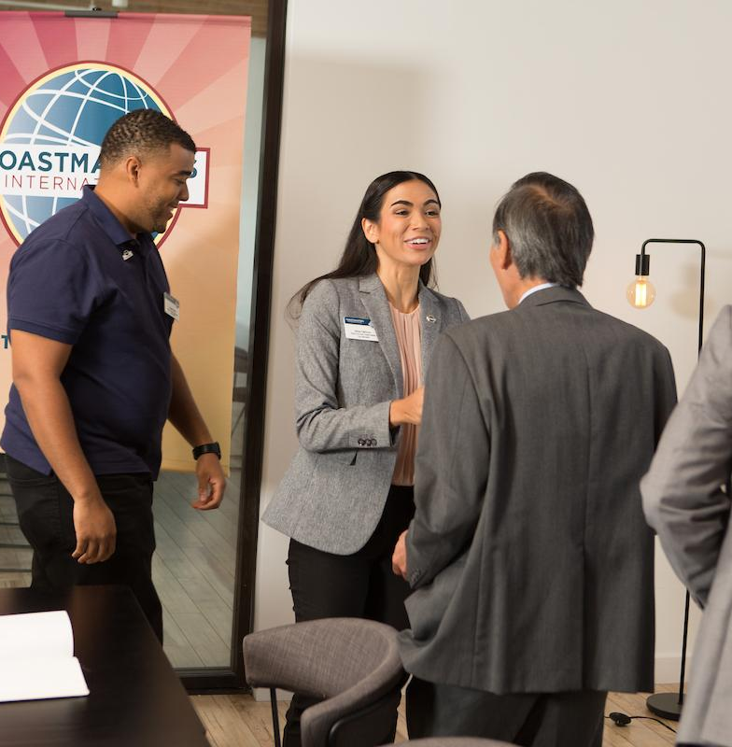
Upon Arrival at Club Meetings
Arrange meeting room early
Arrange tables and chairs
Set out meeting materials and promotional materials
Check room temperature
Ask guests to sign the Guest Book

Slide 11

During Club Meetings
Open Meeting
Recite the Club Mission Statement and Housekeeping rules
Welcome late arrivals
Coordinate food service, if any
Collect ballots and tally votes when necessary

Slide 12
During Club Meetings
SAA in an Online Meeting
In the online environment, the Sergeant at Arms can also act as the moderator for the meetings. This will allow them to set the expectations at the beginning of the meetings to ensure they are conducted with the professional atmosphere of a Toastmasters club meeting

Slide 13
Club Mission Statement
We provide a supportive and positive learning environment in which members are empowered to develop communication and leadership skills, resulting in greater self confidence and personal growth.

Slide 14
After Club Meetings
Return room to original configuration.
Pack up and store materials.
Dispose of trash.

Slide 15

Outside the Club Meeting
Schedule meeting location
Ensure adequate supplies are available
Attend executive committee meetings
Arrange your replacement or assistance
Prepare your successor for office

Slide 16
The Executive Committee
Update the executive committee on the club meeting space status.
Work to coordinate meeting space.
Chair Social and Reception Committee.
Replace items as needed.

Slide 17
SAA Responsibility Action Plan
How will you fulfill this responsibility?
When will each action be completed?
Who is available to help you?
What materials and resources can you use?

Slide 18

Getting Started
Attend district -sponsored club-officer training program.
Read materials.
Meet with outgoing executive committee.
Meet with outgoing SAA.
Meet with current executive committee.
Introduce yourself to meeting space contacts.
Ask for volunteers to assist you.

Slide 19
SAA Resources

Slide 20
Additional Resources
Club Leadership Handbook https://www.toastmasters.org/resources/club-leadership-handbook
Distinguished Club Program and Club Success Plan (Item 1111)
www.toastmasters.org/1111
Ordering club supplies www.toastmasters.org/successfulmeetings
Ballots and Brief Evaluations www.toastmasters.org/163

Slide 21
Questions?

Slide 22
All The Best!

