Slide 1
Secretary
Club Officer Training

Slide 2
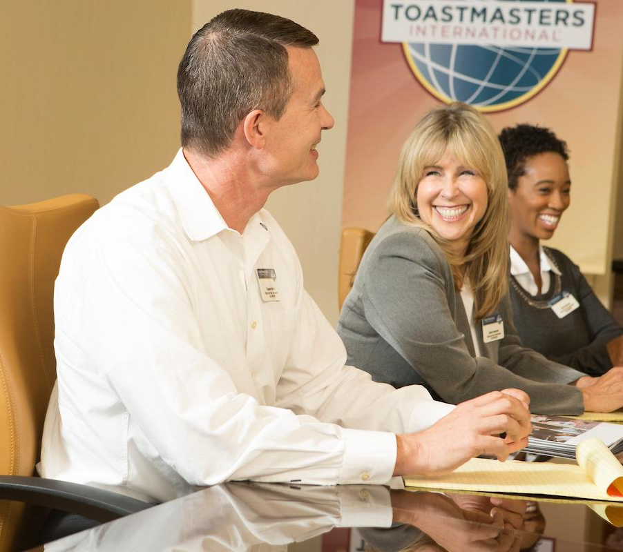

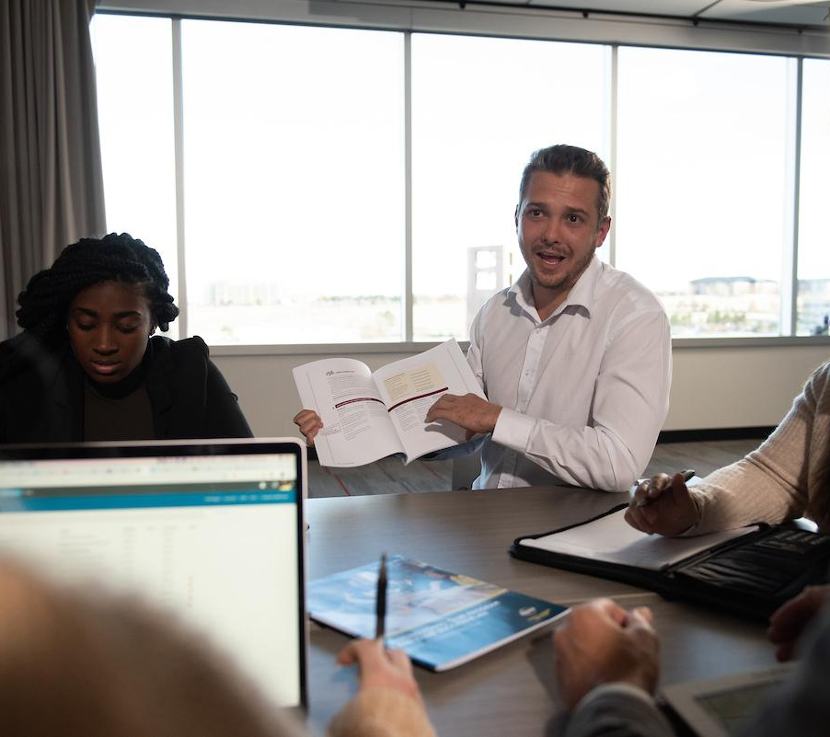
Meeting Agenda
Secretary Role
Secretary Responsibilities
Secretary Resources

Slide 3
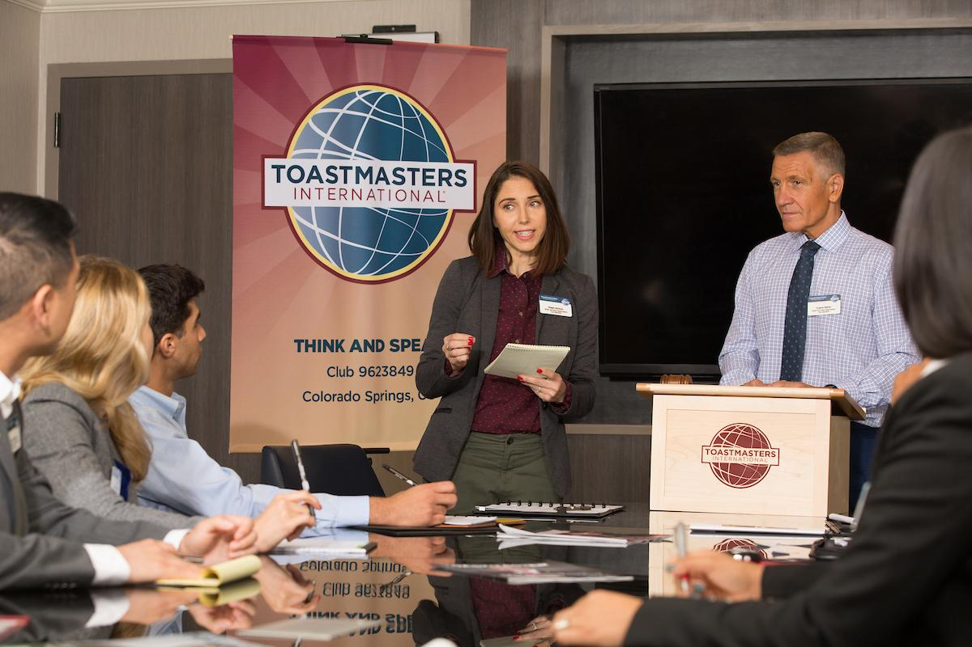
Session Objectives
To identify your role
To fulfill your responsibilities
To find resources that help you to support the club’s mission

Slide 4
SECRETARY AS STATED IN CLUB CONSTITUTION
“The club secretary is responsible for club records and correspondence.
The club secretary has custody of the club’s charter, constitution, and bylaws and all other records and documents of this club;
keeps an accurate record of the meetings and activities of this club and of the club executive committee;
maintains an accurate and complete roster of individual members of this club, including the address and status of each individual member and transmits the same to the successor in office.
The club secretary provides notices of meetings as required by this constitution, and immediately notifies World Headquarters of Toastmasters International of any change in the roster of individual members.”

Slide 5
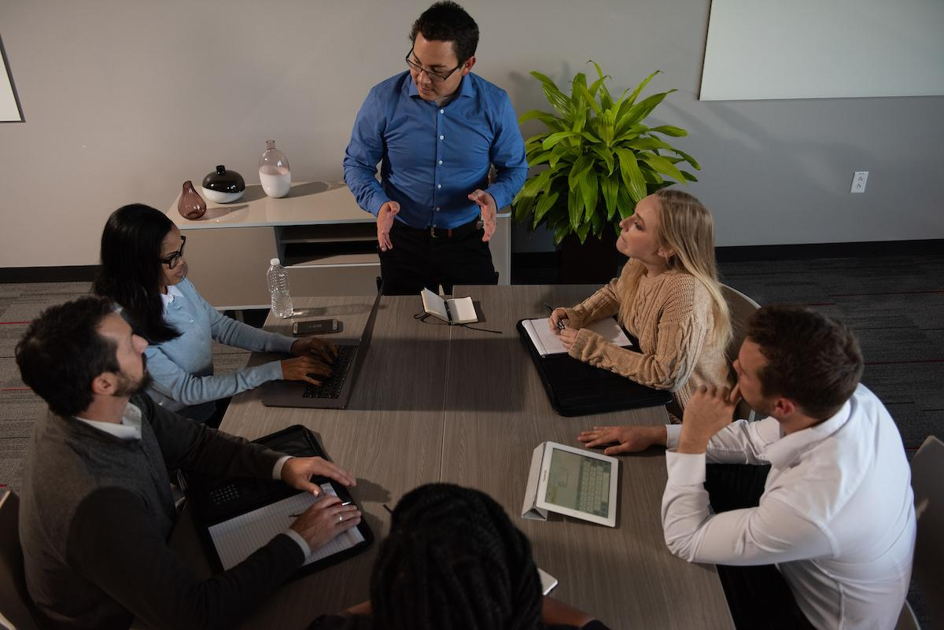
Role of Secretary
As secretary, you take notes, maintain files and report new officers.
Everything you do as secretary supports the club mission.

Slide 6
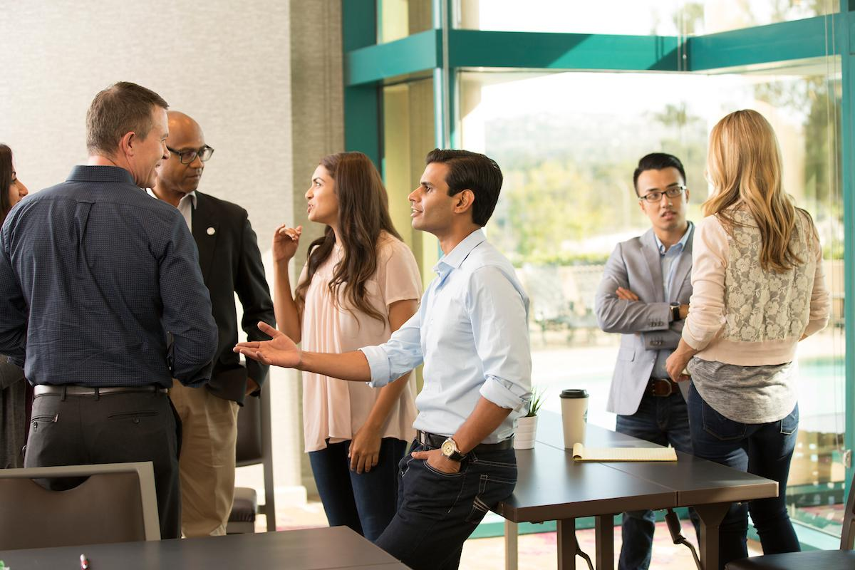

Secretary Responsibilities
The Club Meeting
Outside The Club Meeting
During The Club Meeting

Slide 7
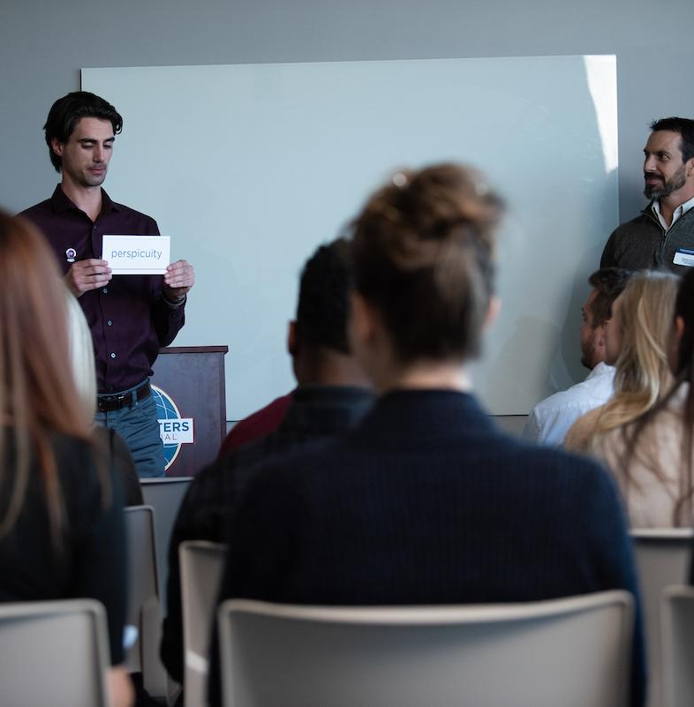
The Club Meeting
Before Club Meetings
Upon Arrival at Club Meetings
During Club Meetings

Slide 8

Before Club Meetings
Post the previous minutes online and notify the club members to view the minutes.
Prepare a list of actions for the president to be taken during the meeting.
Update the club’s officer list when necessary.

Slide 9
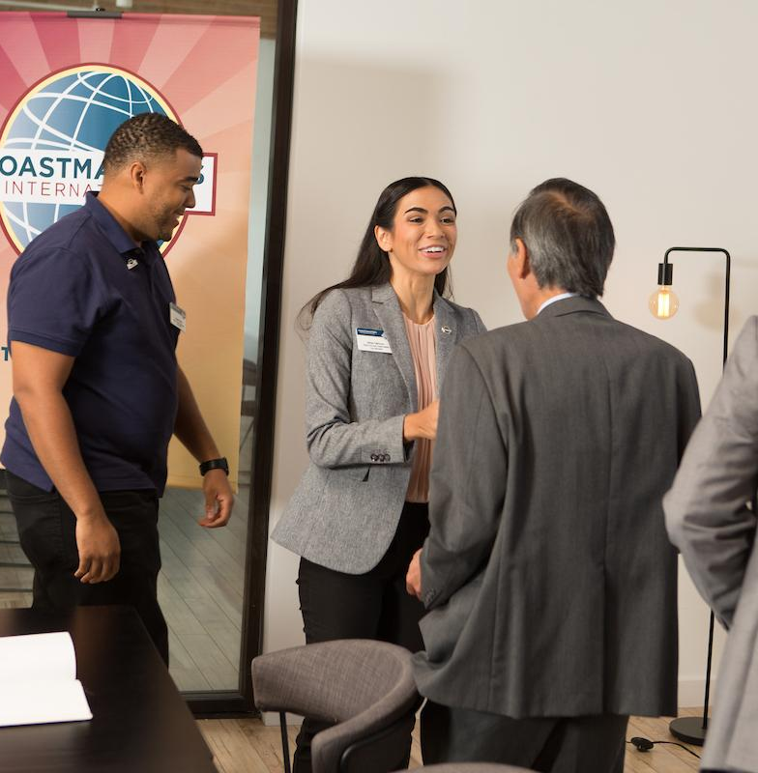
Upon Arrival at Club Meetings
In Person Meetings:
Circulate attendance sheet and guest book.
Virtual Meetings:
Document attendance.

Slide 10

During Club Meetings
Read previous minutes.
Note amendments and record current meeting minutes.

Slide 11

Outside the Club Meeting
Maintain accurate roster and submit to treasurer to submit with dues.
Submit club officer list to World Headquarters 10 days after club elections.
Handle correspondence.
Keep club files which includes club constitution, bylaws and club charter.
Attend club executive committee meetings.

Slide 12
Outside the Club Meeting
Vote at international business meetings.
Facilitate member progress in Base Camp.
Arrange for your replacement or assistance if unable to attend meetings..
Prepare your successor for office.

Slide 13
The Executive Committee
Read the previous meeting minutes.
Note amendments.
Record the current meeting minutes.

Slide 14
Responsibility Checklist
Maintain soft and hard copies of documents properly and consistently.
Circulate the attendance sheet and guest book during the meeting.
Work closely with the VPE,VPM and the President. You also are the pivot to the President,VPE, VPM and treasurer of your club.
Council voting.
Maintain updated roster.
You are one of the Basecamp Managers.

Slide 15
Responsibility Checklist
Update details in Dashboard/drive.
Make the Minutes of meeting in your own style.
Find your associate and share your responsibilities.
Update club officers in Club central.
Be the default shoot master for your club meetings.
Understand basic parliamentary procedures.
Order supplies as needed.
Remain current with the Leader Letter.

Slide 16
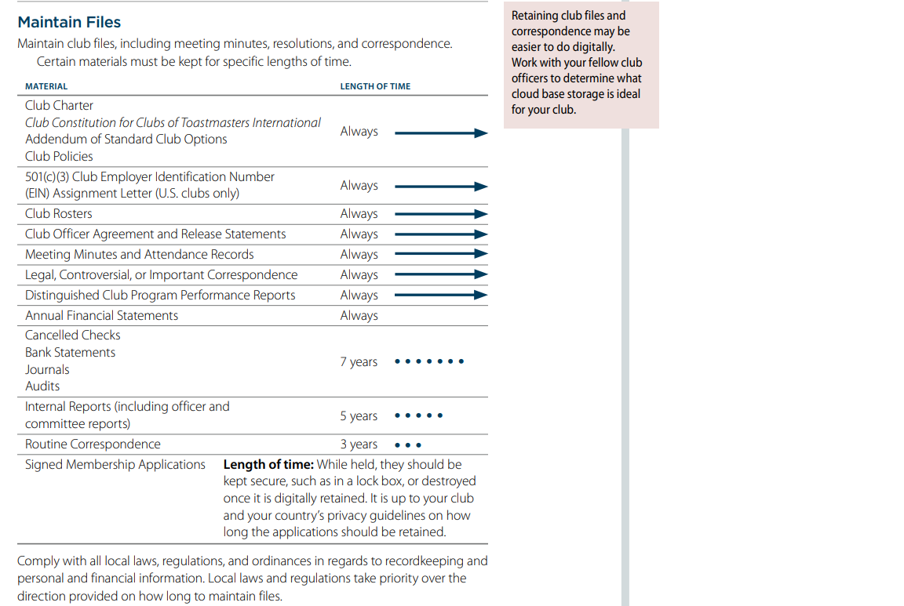
How Long to Maintain the Records?

Slide 17

Secretary Responsibilities
How
When
Who
What

Slide 18
Contents of the Dashboard
1. Meeting planner
2. Members Progress
3. Buddies list
4. Attendance
5. Guest list
6. Important links
7. Mentor-mentee list
8. Contest details
9. Meeting Dates
10. Birthday and special days

Slide 19
Responsibility Action Plan
How will you fulfill this responsibility?
When will each action be completed?
Who is available to help you?
What materials and resources can you use?

Slide 20
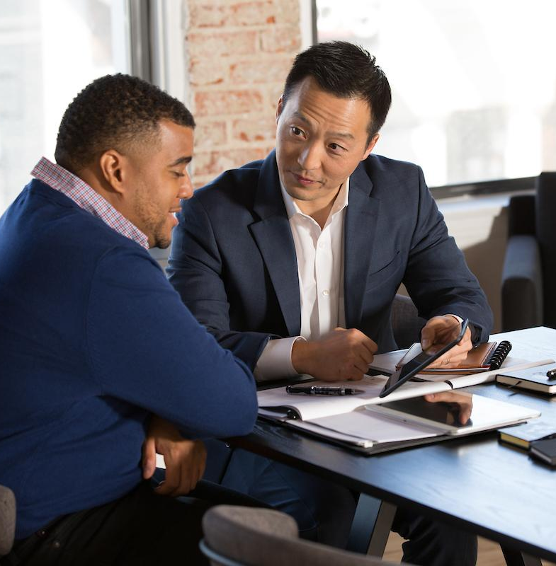
Getting Started
Attend district-sponsored club -officer training program.
Read materials.
Meet with outgoing executive committee.
Meet with outgoing secretary.
Meet with current executive committee.
Confirm submission of the newly elected officers list.
Review and order any needed materials.

Slide 21
Useful Tips
Include all the interesting things that happened during the meeting
Add all role-players
Project speeches and speech highlights
Evaluation...Points of improvement and Summary
Table topics-Highlights
Keep the template ready
For preparing video MOM -
▪ PowerPoint -save as mp4
▪ Google photos
▪ Piccollage or Windows movie maker

Slide 22
Adopting New Challenges
Create a club Login
Save all documents in Drive
Forms for guests details

Slide 23
Skills Developed
Listening Skills
Writing skills.
Creativity
Organization and problem-solving.
Record maintenance.
Critical thinking.
Meeting organization.
Document decisions agreed to at meetings and communicate decisions to larger audiences.
Compliance with standard procedures.

Slide 24
Additional Resources
Distinguished Club Program and Club Success Plan (Item 1111)
Guest Book (Item 84)
Club officer list
Use of Toastmasters materials
www.toastmasters.org/1111
www.toastmasters.org/84
www.toastmasters.org/clubcentral
www.toastmasters.org/memberlists

Slide 25
Questions?

Slide 26
All The Best!

