Slide 1
Treasurer
Club Officer Training

Slide 2



Agenda
Treasurer Role
Treasurer Responsibilities
Treasurer Resources

Slide 3
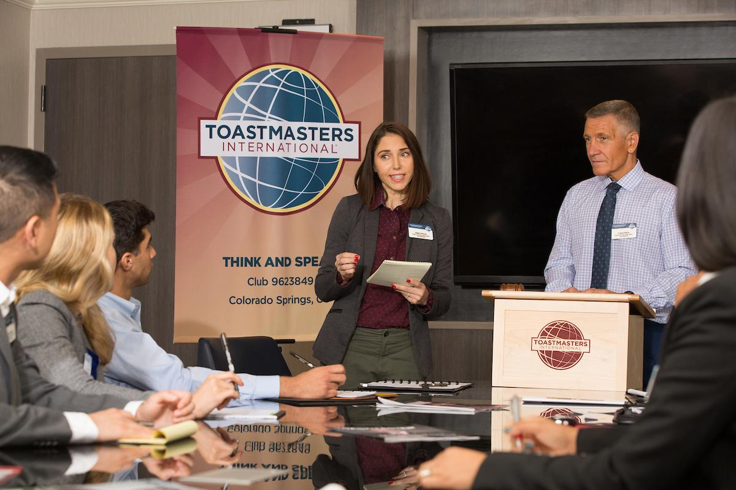
Session Objectives
Identify your role
Fulfill your responsibilities
Find resources that help you

Slide 4
Treasurer Role

Slide 5
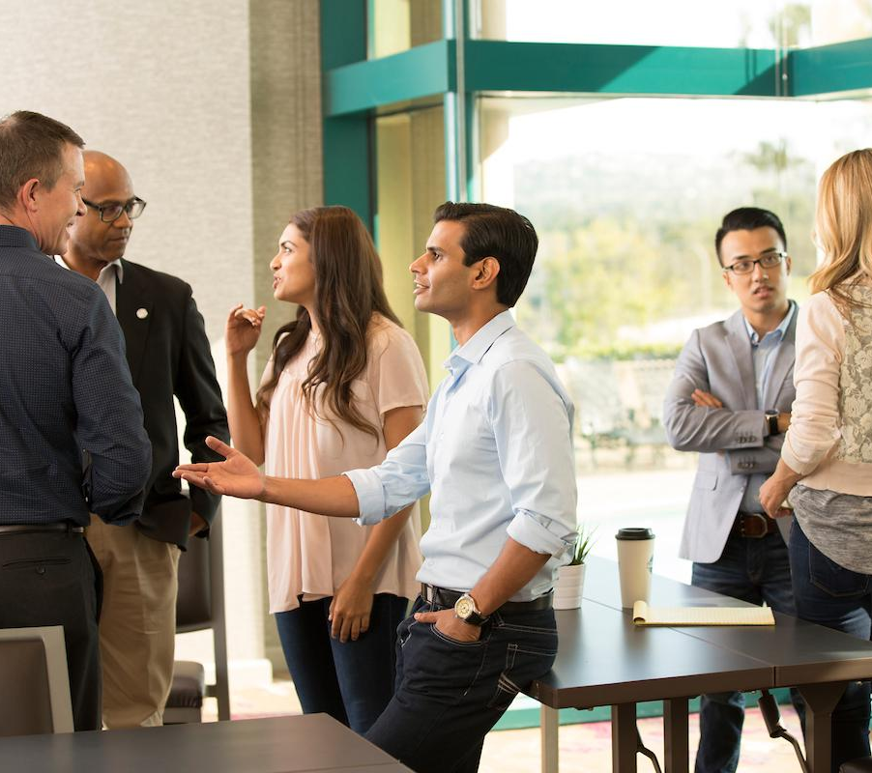

Treasurer Responsibilities
The Club Meeting
Outside the Club Meeting
The Executive Committee

Slide 6
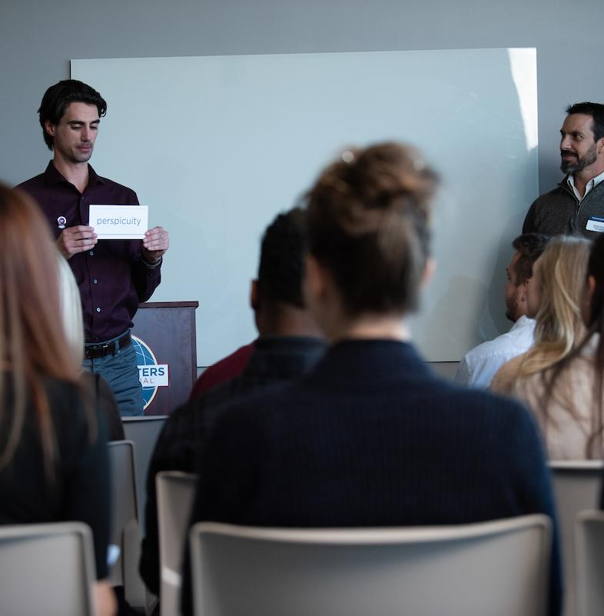
The Club Meeting
Before Club Meetings
Upon Arrival at Club Meetings
During Club Meetings

Slide 7

Before Club Meetings
Prepare a financial report.

Slide 8

During Club Meetings
Collect membership dues.
Report on club finances.

Slide 9

Outside the Club Meeting
Prepare a budget.
Provide bank with a bank signatory card.
Collect and pay dues.
Submit new member applications.
Issue checks for club expenses.
Keep financial records.

Slide 10
Outside the Club Meeting
Present financial reports.
Submit club accounts for audit.
Attend executive committee meetings.
Reconcile deposits, expenditures and cash on hand.

Slide 11
Outside the Club Meeting
Ensure club meets government tax regulations.
Receive financial correspondence.
Prepare for audit committee.

Slide 12
The Executive Committee
Prepare a budget.
Present financial reports.
Submit club accounts for audit.
Work with executive committee on Club Success Plan.

Slide 13

How to Fulfill the Treasurer Responsibilities
How
When
Who
What

Slide 14
Treasurer Responsibility Action Plan
How will you fulfill this responsibility?
When will each action be completed?
Who is available to help you?
What materials and resources can you use?

Slide 15
Treasurer Resource

Slide 16

Getting Started
Attend district-sponsored club officer training program.
Read materials.
Meet with outgoing executive committee.
Meet with outgoing treasurer.
Meet with current executive committee.
Review Policies and Protocol.
Prepare a budget.

Slide 17
Additional Resource
Distinguished Club Program and Club Success Plan (Item 1111)
Success Communication Series and Success Leadership Series
Submitting club dues
Use of Toastmasters materials
www.toastmasters.org/1111
www.toastmasters.org/successprograms
www.toastmasters.org/clubcentral
www.toastmasters.org/memberlists

Slide 18
Questions?

Slide 19
All The Best!

