Slide 1
Vice President Education (VPE)
Club Officer Training

Slide 2



Agenda
VPE Role
VPE
Responsibilities
VPE Resources

Slide 3
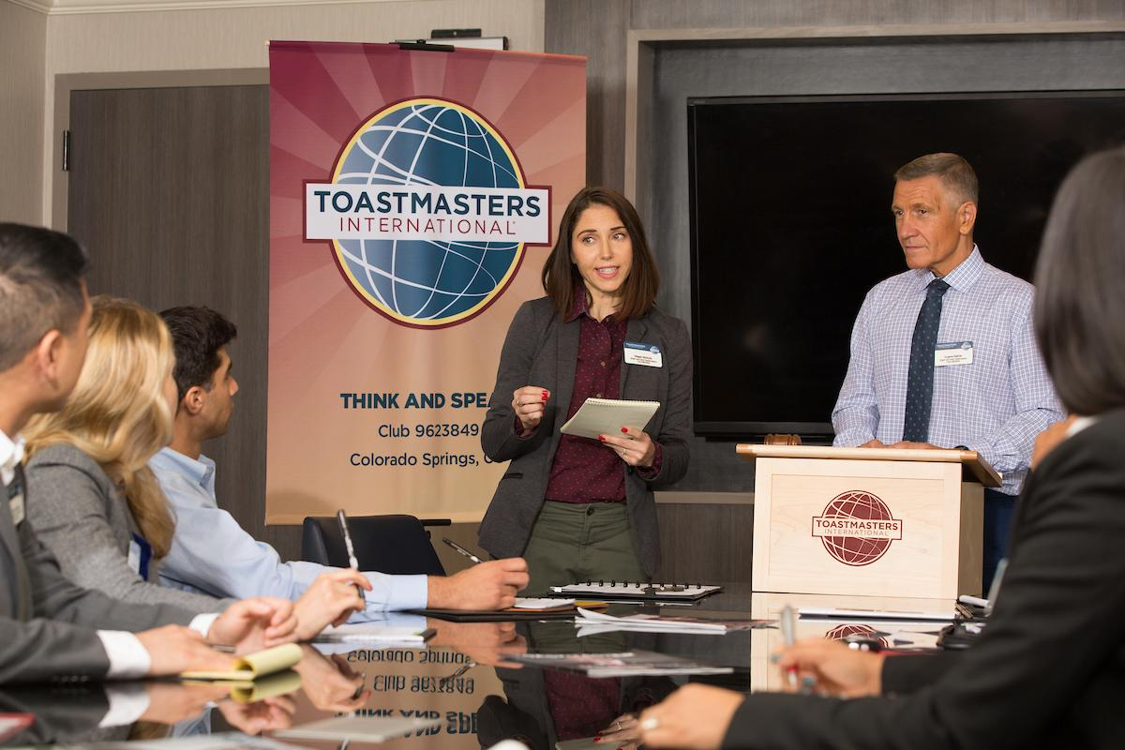
Session Objectives
Identify your role
Fulfill your responsibilities
Find resources that help you

Slide 4
VPE Role

Slide 5


VPE Responsibilities
The Club Meeting
Outside the Club Meeting
The Executive Committee

Slide 6
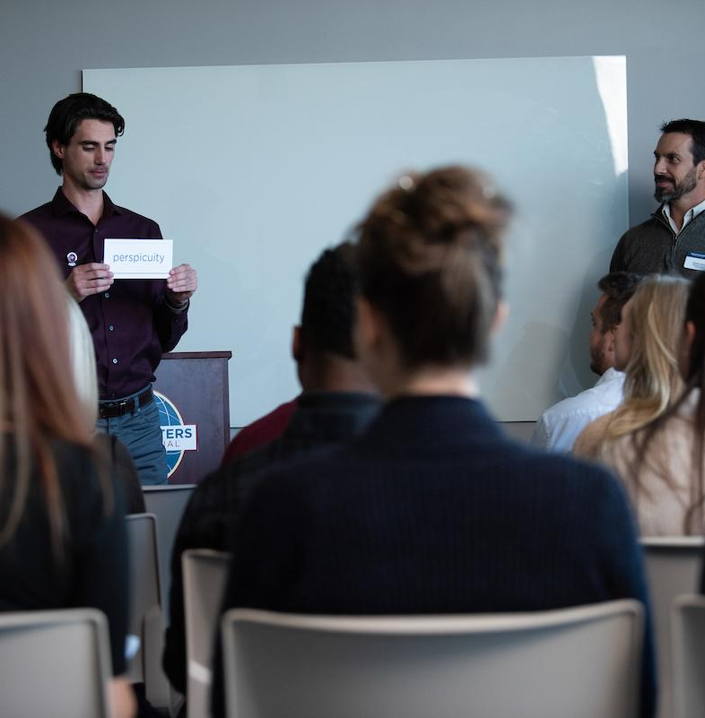
The Club Meeting
Before Club Meetings
Upon Arrival at Club Meetings
During Club Meetings

Slide 7

Before Club Meetings
Review scheduled roles.
Offer support to the Toastmaster.
Schedule education sessions.
Notify the club president of education awards.

Slide 8
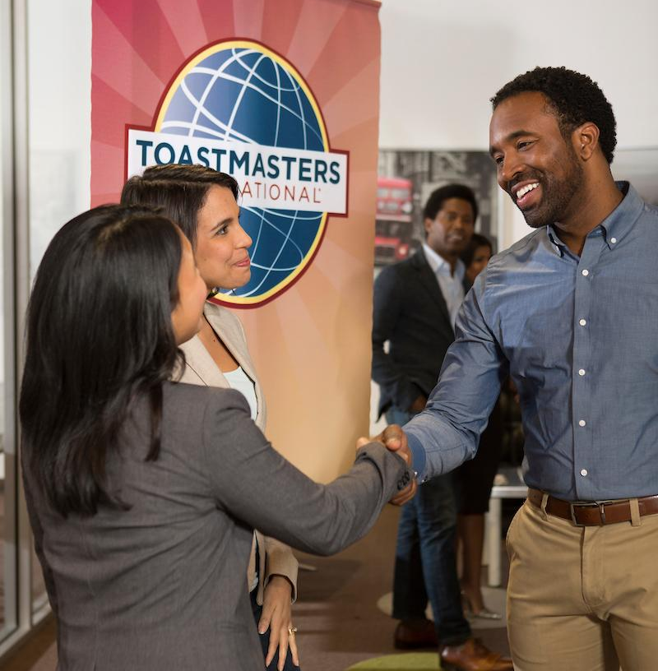
Upon Arrival at Club Meetings
Verify assigned members have arrived and are prepared.
Remind members to select an evaluator.
Assist the Toastmaster.
Greet guests.
Inform Topicsmaster of any guests willing to participate

Slide 9

During Club Meetings
Initial project completion records
Ensure members fill out award applications
Recognize members for achievements
Preside over meeting when necessary
Answer education program or speech contest questions

Slide 10

Outside the Club Meeting
Plan club meetings
Promote participation in the education program
Orient new members
Encourage new members to participate
Assign a mentor
Attend club executive committee meetings
Attend district council meetings

Slide 11
Outside the Club Meeting
Plan Speech Contests Speech Contest Rulebook (Item 1171)
Refer to it as necessary when planning speech contests
Find out which speech contests your District is scheduled to host during your term of office and plan your club contests accordingly

Slide 12
Outside the Club Meeting
Facilitate member progress on Base Camp.
Arrange for your replacement or assistance.
Prepare your successor for office.

Slide 13
Outside the Club Meeting
Manage Mentor Program
Assign every new member a mentor and keep track of who is mentoring whom.
The Club Mentor Program Kit (Item 1163) provides everything needed to start a mentoring program for club members.
Encourage members of your club to complete the Pathways Mentor program and as much as possible, assign mentors who are working in or have completed the program.

Slide 14
The Executive Committee
Prepare and present education program reports.
Share information on upcoming speech contests.

Slide 15

How to Fulfill the VPE Responsibilities
How
When
Who
What

Slide 16
VPE Responsibility Action Plan
How will you fulfill this responsibility?
When will each action be completed?
Who is available to help you?
What materials and resources can you use?

Slide 17
VPE Resource

Slide 18

Getting Started
Invite 1 -3 members to serve on education committee
Meet with each member to discuss educational goals

Slide 19
Additional Resource
www.toastmasters.org/speechcontestswww.toastmasters.org/1171
www.toastmasters.org/1111
www.toastmasters.org/1111C
www.toastmasters.org/306
Speech contest information
Speech Contest Rulebook (Item 1171)
Distinguished Club Program and Club Success Plan (Item 1111)
Distinguished Club Program Goals (Item 11110)
Wall Chart Set (Item 306)

Slide 20
Additional Resource
www.toastmasters.org/265
www.toastmasters.org/accreditedspeakerrules
www.toastmasters.org/edfaq
www.toastmasters.org/memberachievementrecord
www.toastmasters.org/shop
Competent Leadership (Item 265)
Accredited Speaker Program
Education program FAQs
Member Achievement Record (Item 1328)
Educational achievement, gifts and recognition

Slide 21
Questions?

Slide 22
All The Best!

