Slide 1
Vice President Membership (VPM)
Club Officer Training

Slide 2



Agenda
VPM Role
VPM Responsibilities
VPM Resources

Slide 3
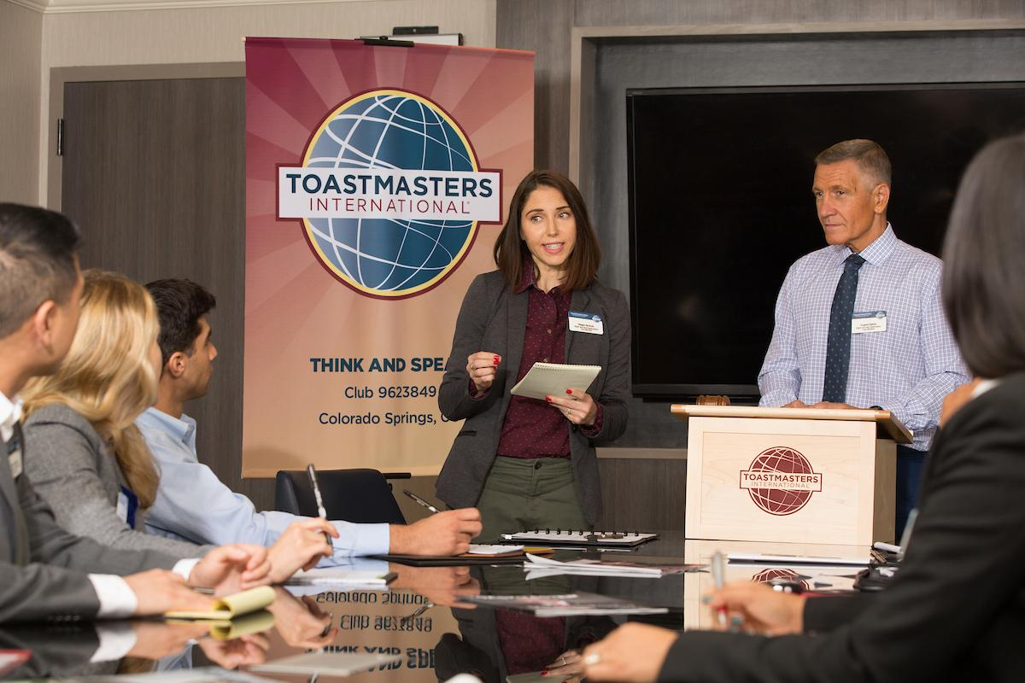
Session Objectives
Identify your role
Fulfill your responsibilities
Find resources that help you

Slide 4
VPM Role

Slide 5


VPM Responsibilities
The Club Meeting
Outside the Club Meeting
The Executive Committee

Slide 6
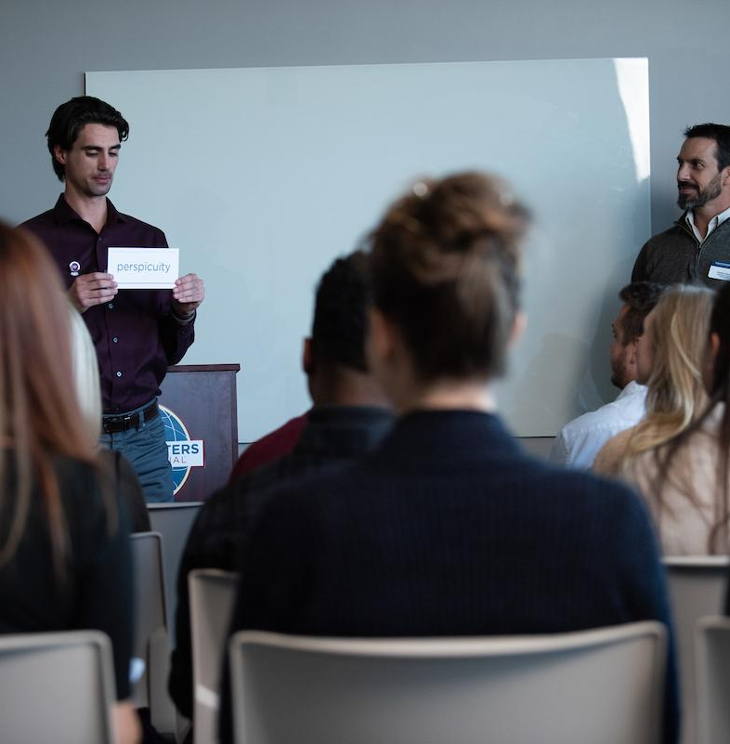
The Club Meeting
Before Club Meetings
Upon Arrival at Club Meetings
During Club Meetings

Slide 7

Before Club Meetings
Make a list of new members.
Have a few Guest Packets (Item 387).
Contact former guests and members who have not been attending meetings.

Slide 8
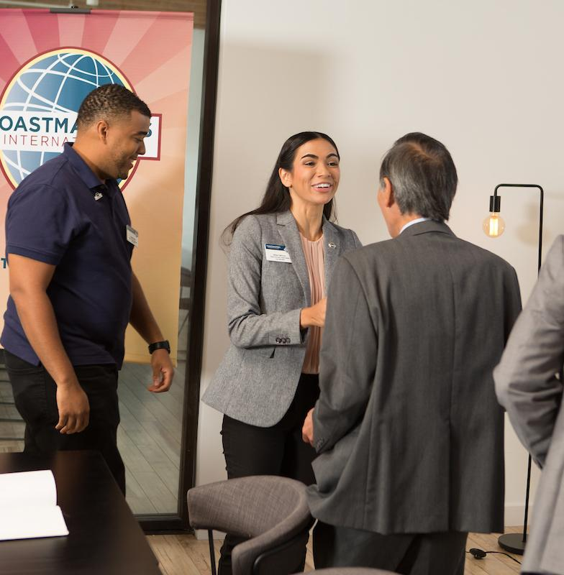
Upon Arrival at Club Meetings
Greet all guests and members.
Provide all guests with Guest Packets (Item 387).
Answer questions guests may have.

Slide 9

After Club Meetings
Meet with guests to answer questions.
Invite guests to join the club.
Help guests complete the membership application.

Slide 10

Outside the Club Meeting
Conduct membership-building programs.
Promote membership goals.
Promote membership-building contests.
Follow up on and keep track of guests.

Slide 11
Outside the Club Meeting
Bring membership applications.
Assist the vice president public relations.
Ensure meeting information is correct.
Attend club executive committee meetings.

Slide 12
Outside the Club Meeting
Attend and vote at area council meetings.
Arrange for your replacement or assistance.
Prepare your successor for office.

Slide 13
The Executive Committee
Organize and conduct membership contests.
Report on club membership.

Slide 14

How to Fulfill the VPM Responsibilities
How
When
Who
What

Slide 15
VPM Responsibility
Action Plan
How will you fulfill this responsibility?
When will each action be completed?
Who is available to help you?
What materials and resources can you use?

Slide 16
VPM Resource

Slide 17

Getting Started
Invite one to three members to serve on membership committee.
Conduct a member survey on Moments of Truth session.
Create Guest Welcome kits.
Order any required materials.

Slide 18
Additional Resources
Success 101 (Item 1622) www.toastmasters.org/1622
Membership contest information www.toastmasters.org/membershipcontests
Distinguished Club Program and Club Success Plan (Item 1111) www.toastmasters.org/1111
Distinguished Club Program Goals (Item 1111C) www.toastmasters.org/1111C
Speechcraft information www.toastmasters.org/speechcraft

Slide 19
Questions?

Slide 20
All The Best!

