Slide 1
Vice President Public Relations (VPPR)
Club Officer Training

Slide 2



Agenda
VPPR Role
VPPR Responsibilities
VPPR Resources

Slide 3
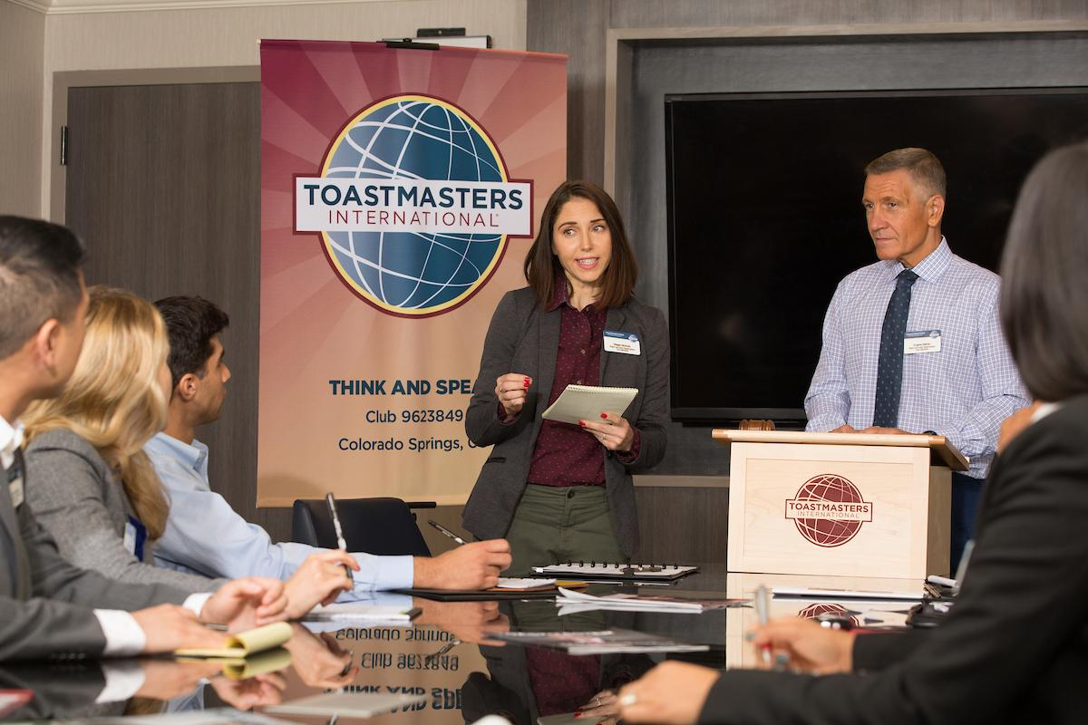
Session Objectives
Identify your role
Fulfill your responsibilities
Find resources that help you

Slide 4

VPPR Role

Slide 5


VPPR Responsibilities
The Club Meeting
Outside the Club Meeting
The Executive Committee

Slide 6
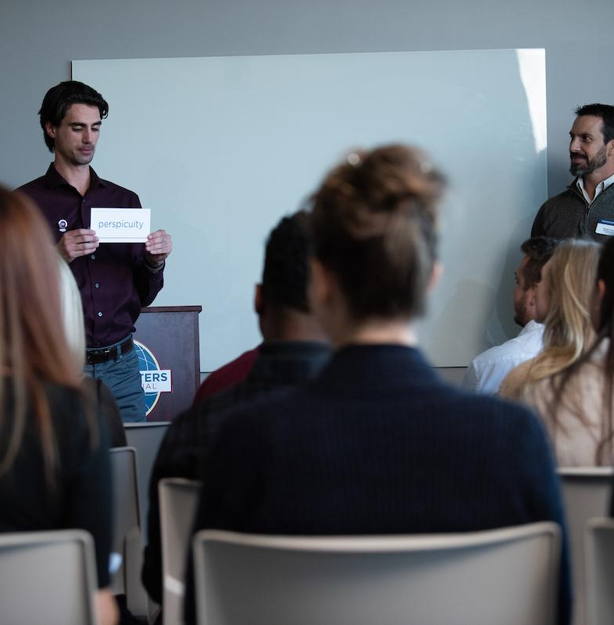
The Club Meeting
Before Club Meetings
Upon Arrival at Club Meetings
During Club Meetings

Slide 7

Before Club Meetings
Verify that information on website and social media is correct.
Order promotional materials.

Slide 8

During Club Meetings
Distribute promotional materials.
Report results of public relations efforts.
Announce public relations campaigns.
Solicit volunteers.

Slide 9

Outside the Club Meeting
Publicize the Toastmasters brand.
Promote the club.
Maintain the club website.
Join a Toastmasters-moderated social networking website.

Slide 10
Outside the Club Meeting
Produce and distribute a club newsletter.
Promote membership programs.
Attend club executive committee meetings.
Attend other Toastmasters events.

Slide 11
Outside the Club Meeting
Arrange your replacement or assistance.
Prepare your successor for office.

Slide 12
The Executive Committee
Provide a public relations report.
Propose new promotion ideas.

Slide 13

How to Fulfill the VPPR Responsibilities
How
When
Who
What

Slide 14
VPPR Responsibility
Action Plan
How will you fulfill this responsibility?
When will each action be completed?
Who is available to help you?
What materials and resources can you use?

Slide 15
VPPR Resource

Slide 16

Getting Started
Attend district -sponsored club -officer training program.
Read materials.
Meet with outgoing executive committee.
Meet with outgoing vice president public relations.
Meet with current executive committee.
Invite one to three members to serve on public relations committee.

Slide 17
Getting Started
Review and order public relations materials.
Solicit articles for website.
Develop media list.

Slide 18
Additional Resource
Let the World Know (Item 1140)
PR Corner
All About Toastmasters (Item 124)
Distinguished Club Program and Club Success Plan (Item 1111)
Brand Portal
Marketing Resources
www.toastmasters.org/1140
www.toastmasters.org/prcorner
www.toastmasters.org/124
www.toastmasters.org/1111
www.toastmasters.org/brandportal
www.toastmasters.org/marketingresources

Slide 19
Questions?

Slide 20
All The Best!

