Slide 1
Pathways
Begin your first project
Notes:
Welcome to the Toastmasters Pathways learning experience, an exciting, flexible and interactive way to develop your skills and help others in your club develop theirs. Pathways helps you learn communication and leadership skills that you need to succeed.

Slide 2
Enter Pathways
Open Your First project

Slide 3
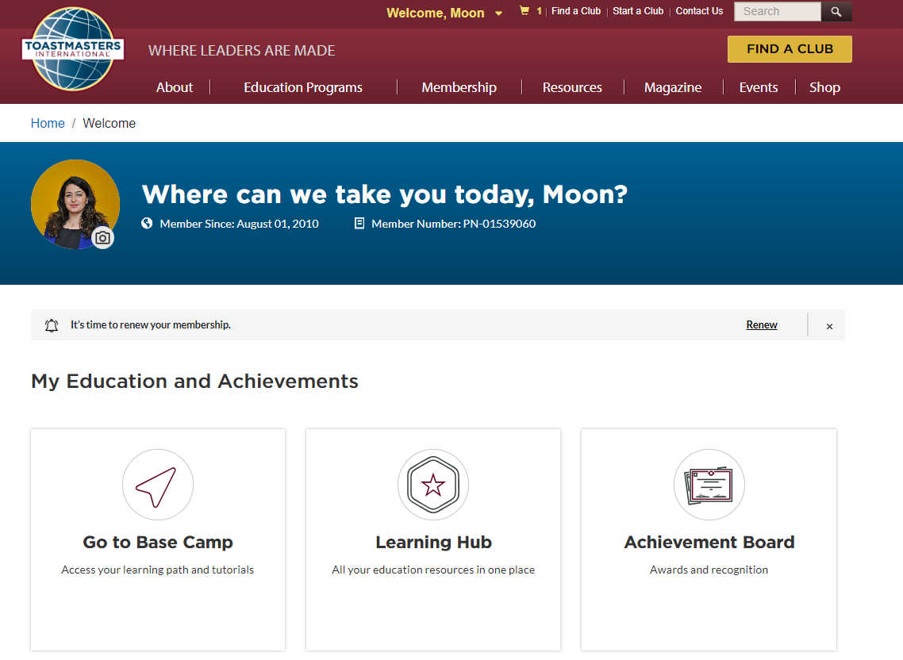
Go to Education Program

Slide 4
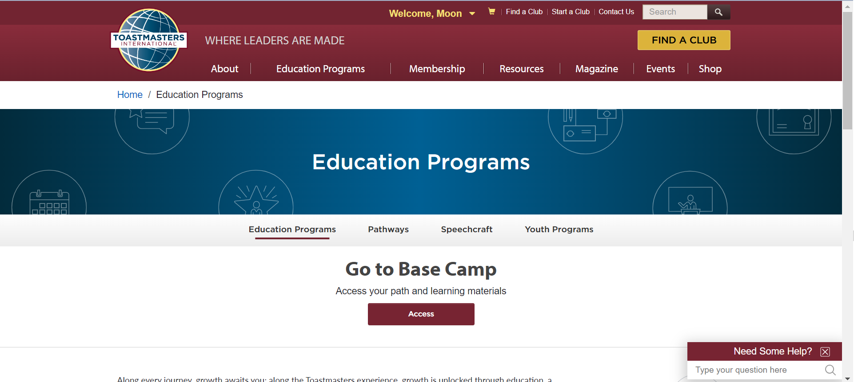
Go to Basecamp

Slide 5
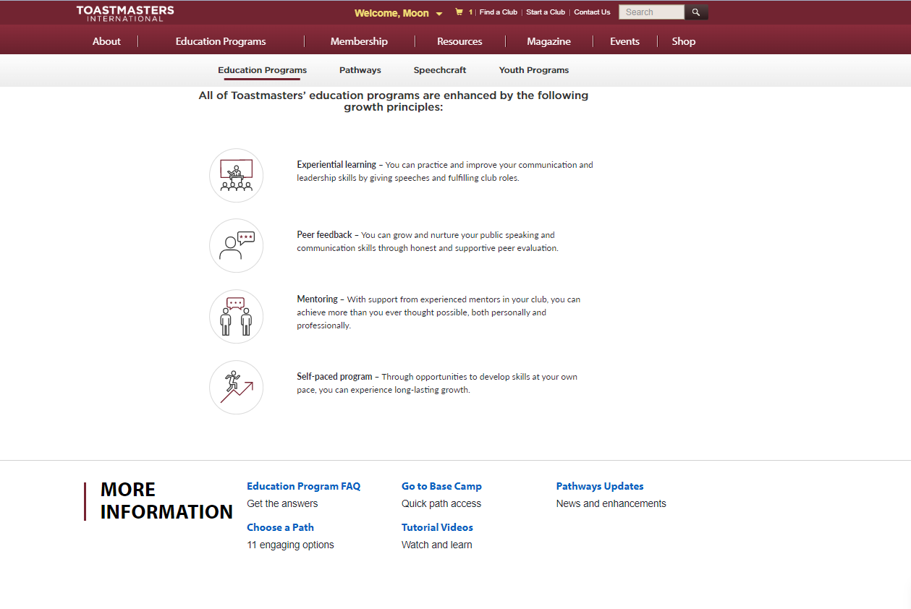
Go to Basecamp - Alternate

Slide 6
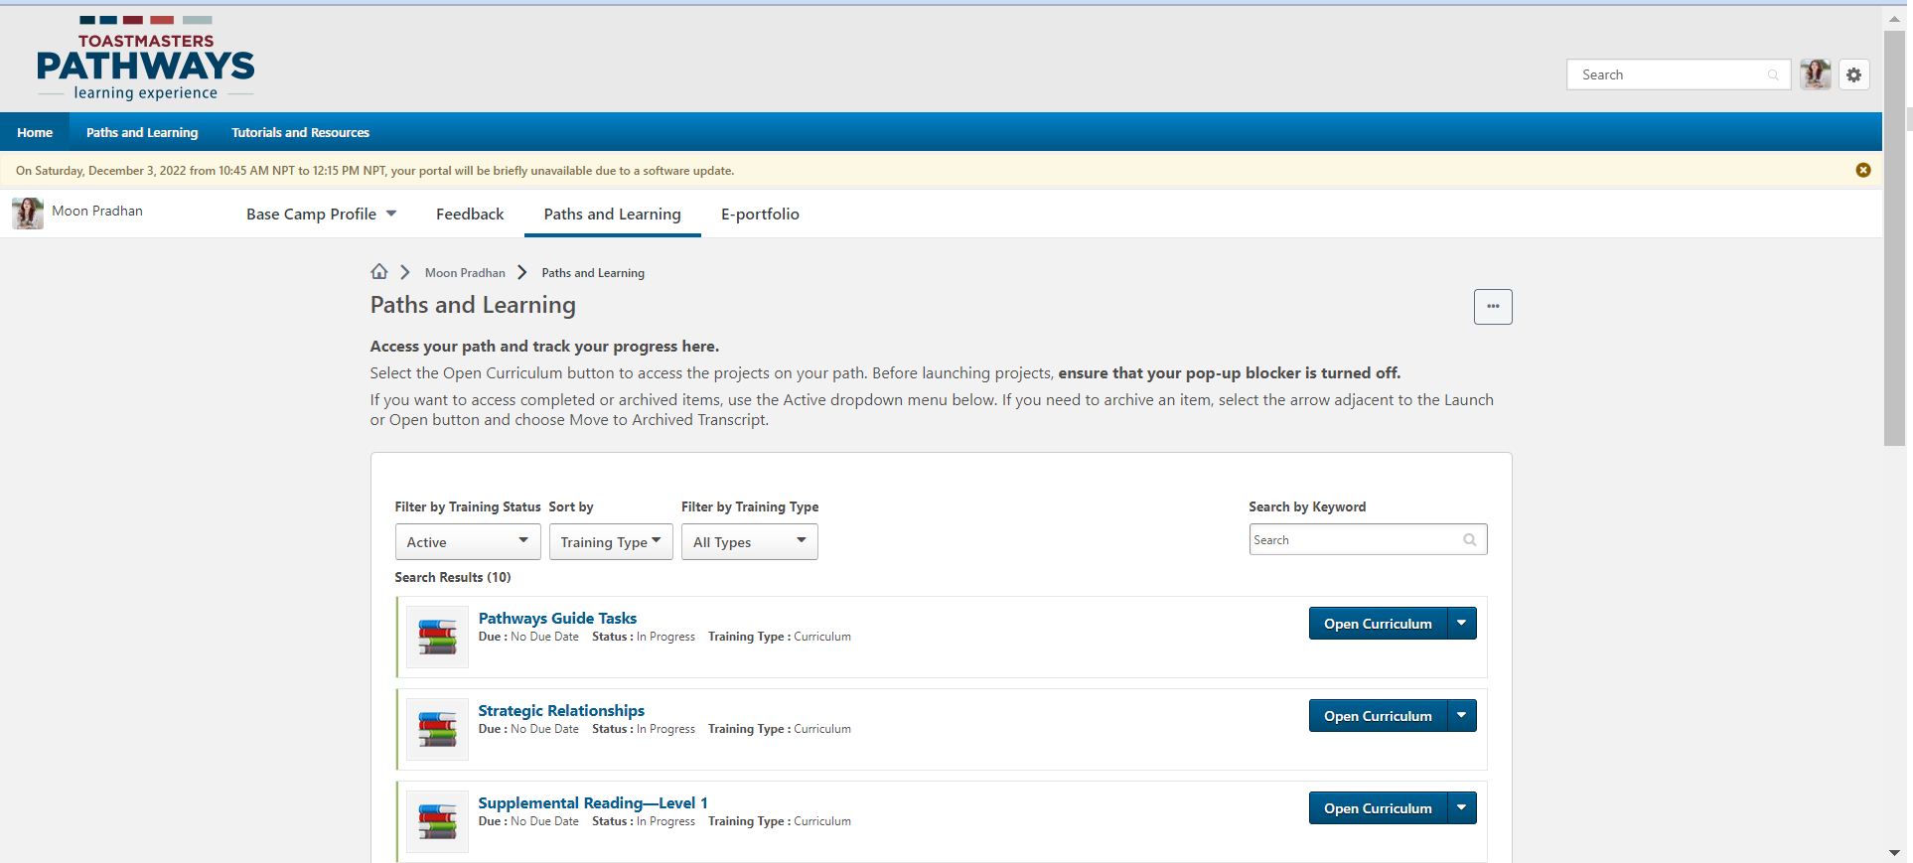
Open Curriculum

Slide 7
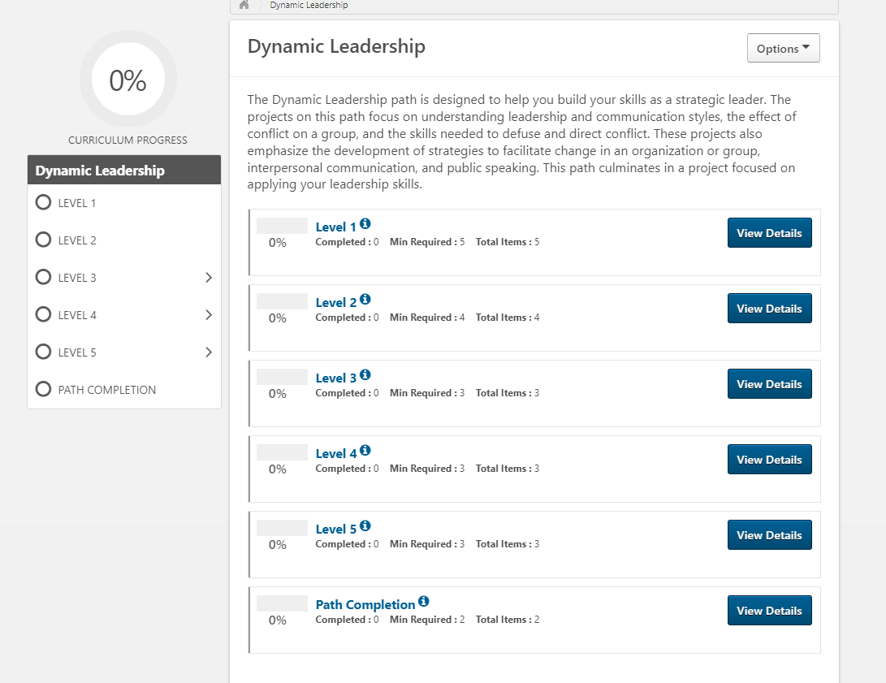

Notes:
Activate and Launch the Level

Slide 8
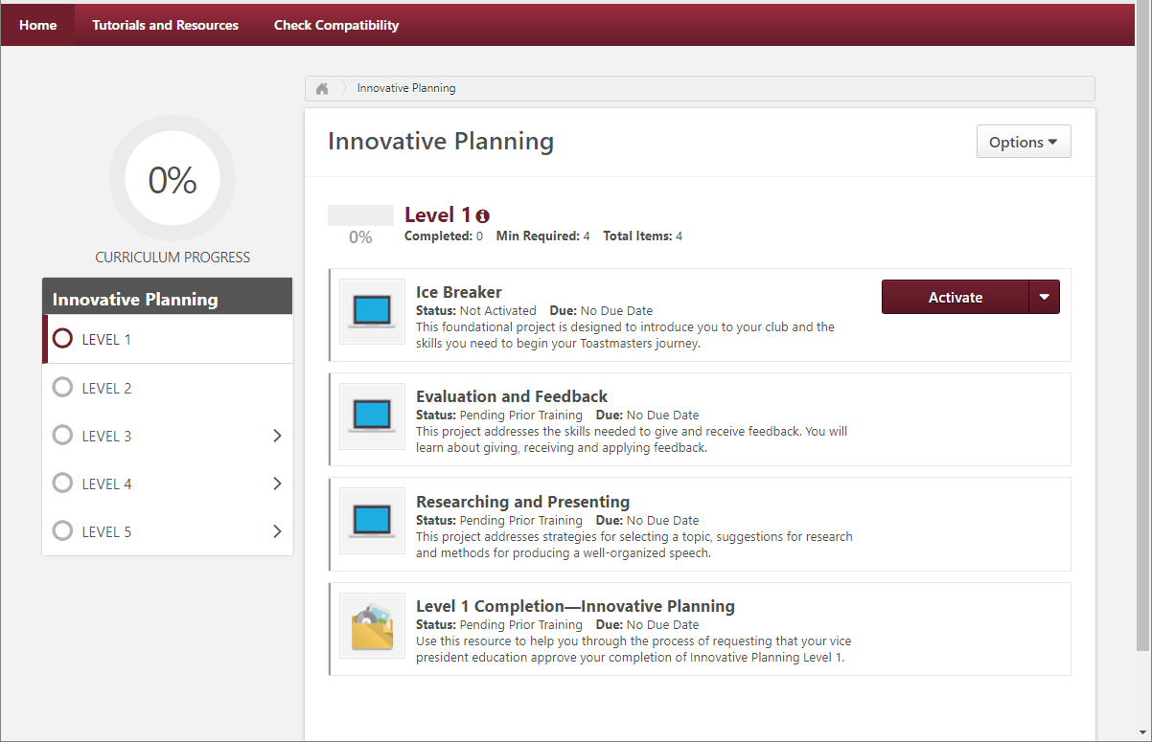

Slide 9
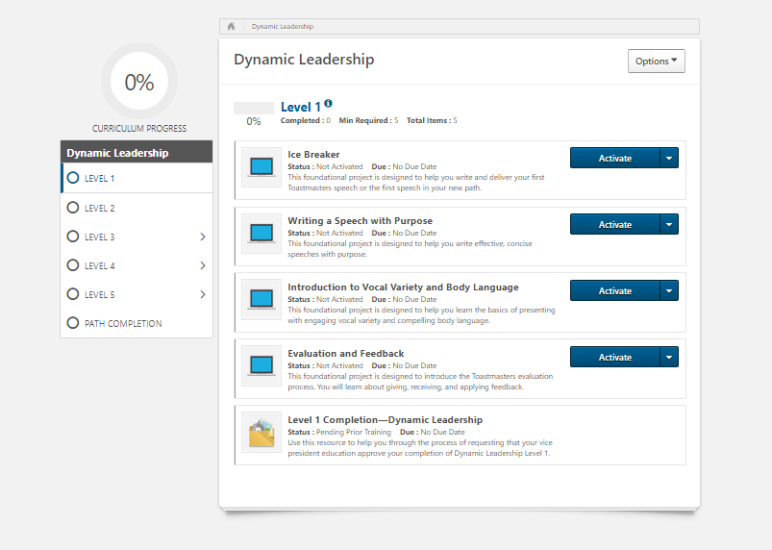
Notes:
Activate and Launch the Project

Slide 10
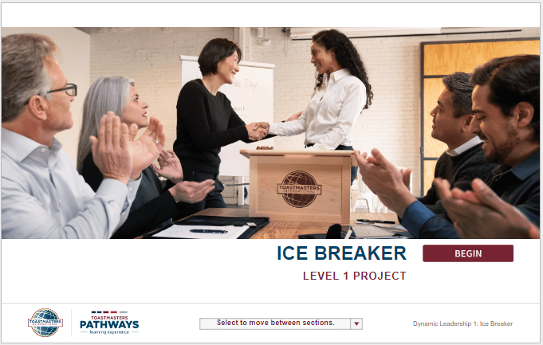

Slide 11
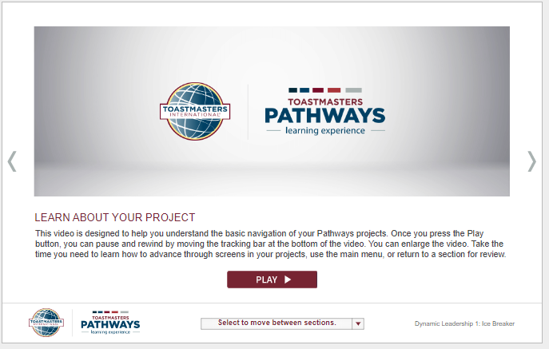

Slide 12
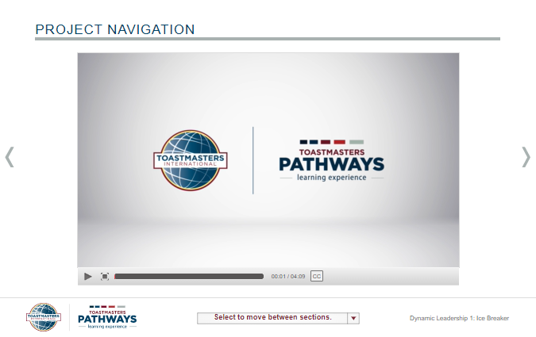

Slide 13
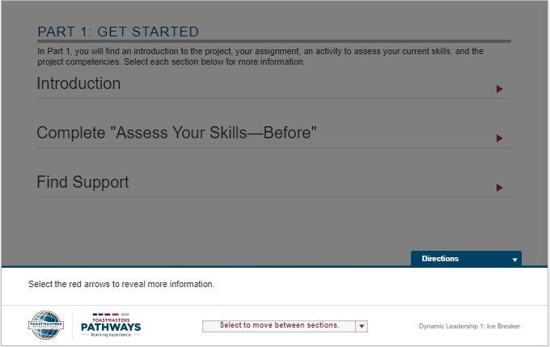

Slide 14
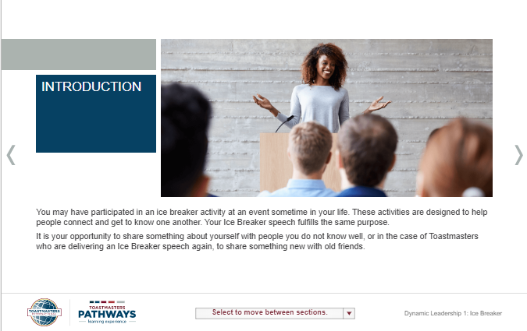

Slide 15
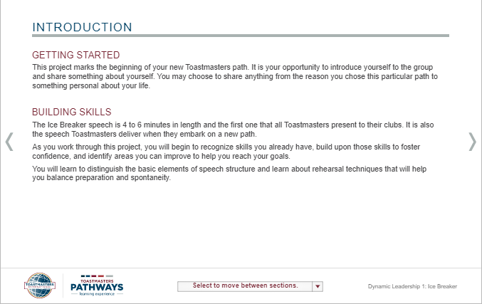

Slide 16
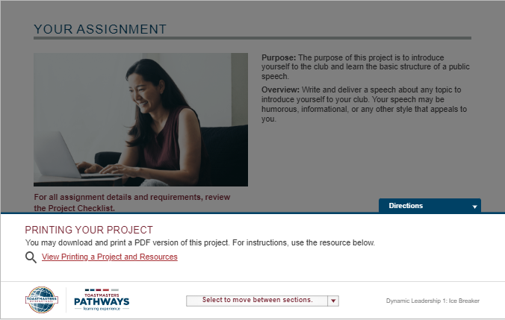

Slide 17
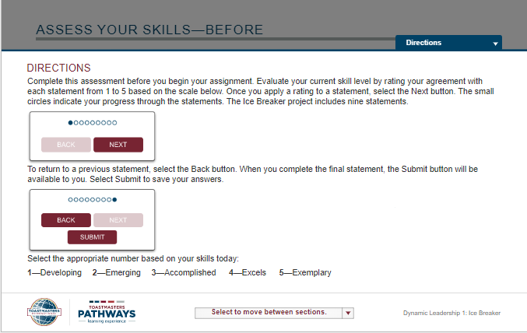

Slide 18
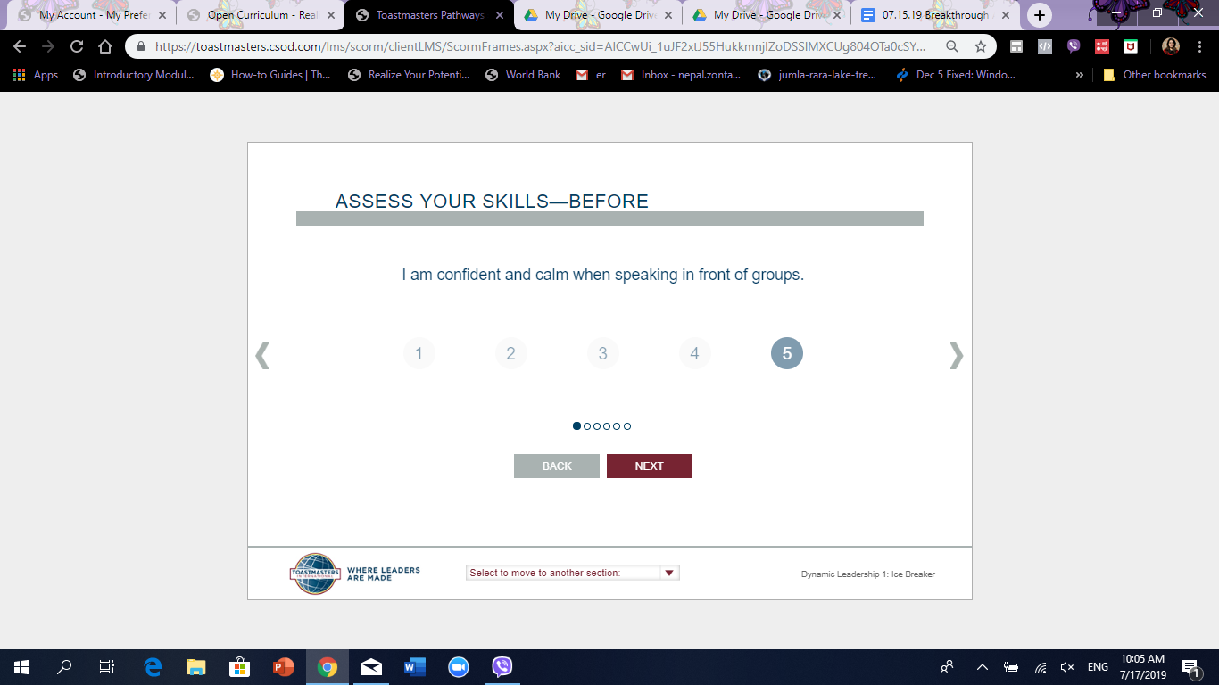
Take the assess your skills - before

Slide 19
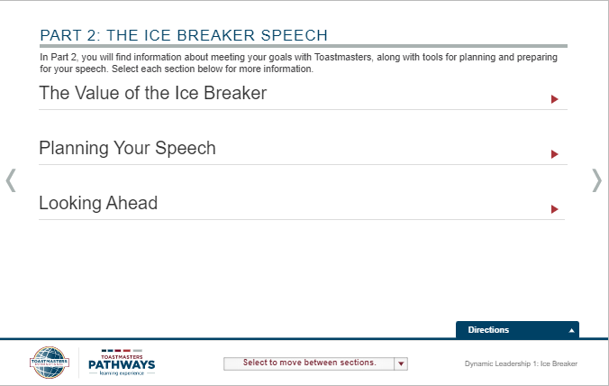

Slide 20
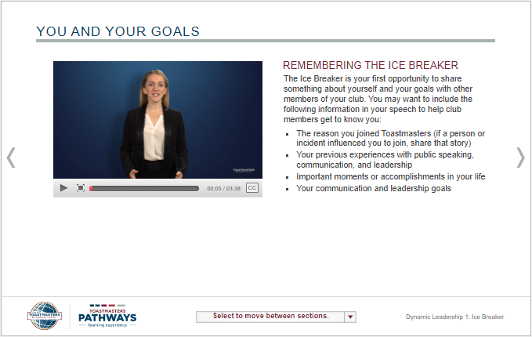

Slide 21
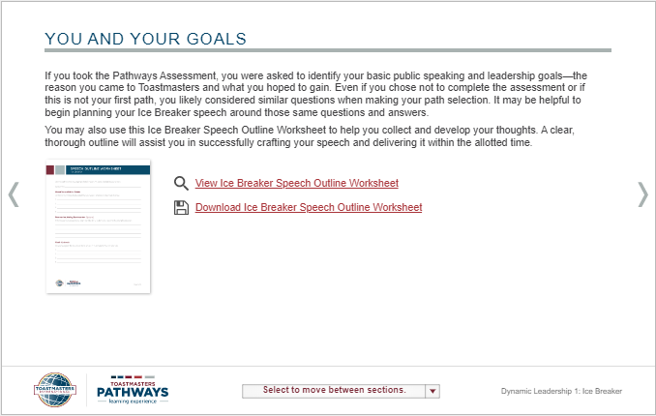

Slide 22
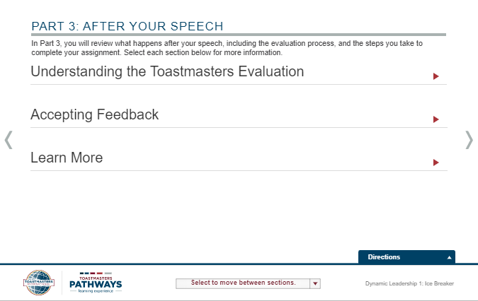

Slide 23
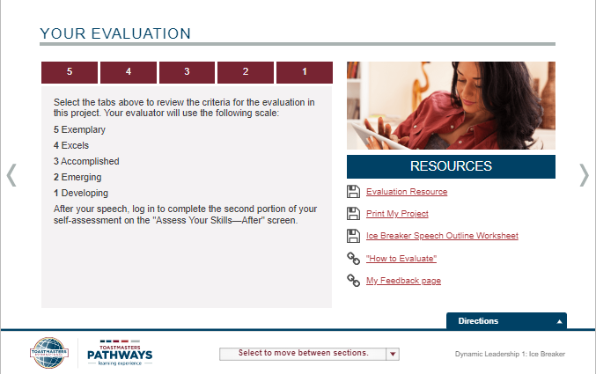
You can download your resources
Notes:
Click Print my project and instead of sending the project to a printer, save to pdf.
Provide the Evaluation resource in print to your evaluator when giving speech.

Slide 24
Completing
Projects,
Levels and
Awards
Online

Slide 25
Completing Projects, Levels and Awards Online
Who Does What?
Member
  Complete a project - give the speech
    Then re-open project, complete Assess Skills-After

Slide 26
Click the right arrow
Notes:
Click Print my project and instead of sending the project to a printer, save to pdf.
Provide the Evaluation resource in print to your evaluator when giving speech.

Slide 27
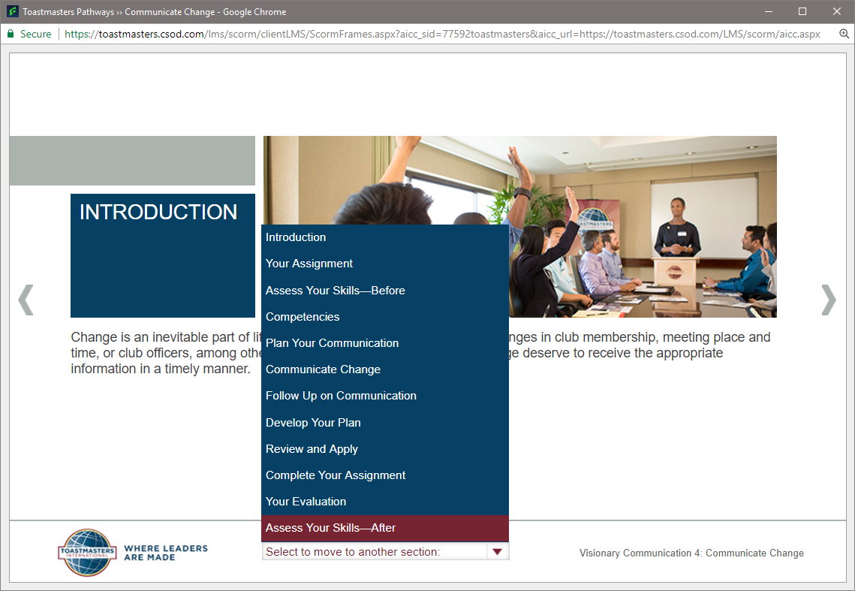
Alternatively, click the drop up button

Slide 28
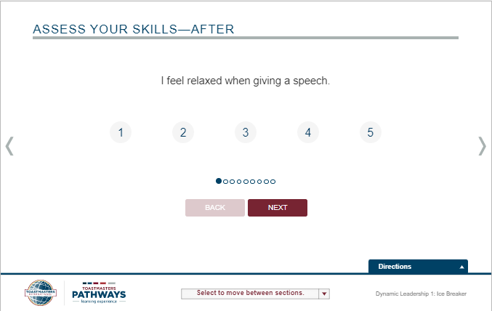
Assess Your Skills - After

Slide 29
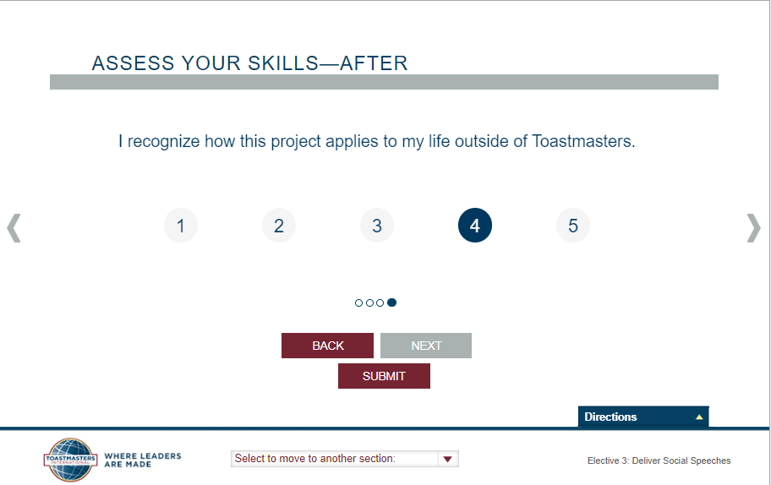

Remember to Submit at the End

Slide 30
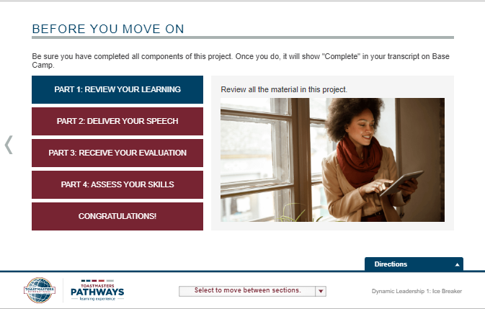

Slide 31
Completing Projects, Levels and Awards Online
Member
  Complete a project
    Re-open project, complete Assess Skills-After
    No approval needed
  Complete a level
    Run the “Level Completion” task in your path

Slide 32
Complete all projects in the level
Notes:
Once all of the projects in the level have been completed, the Level Completion will be activated.

Slide 33
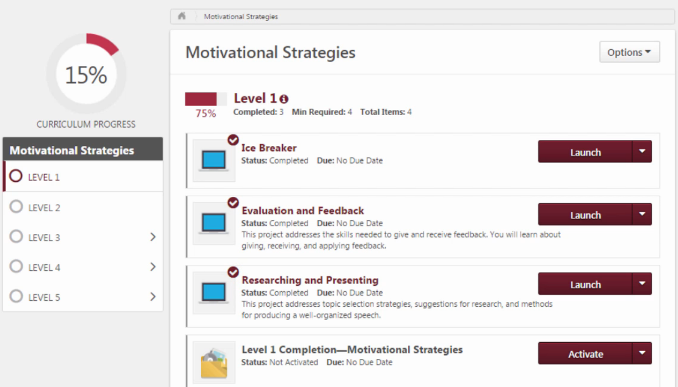
Click Activate – Level Completion
Notes:
If you had chosen the path earlier then the level 1 has three projects and the level completion would be activated like this. Please click Activate.

Slide 34
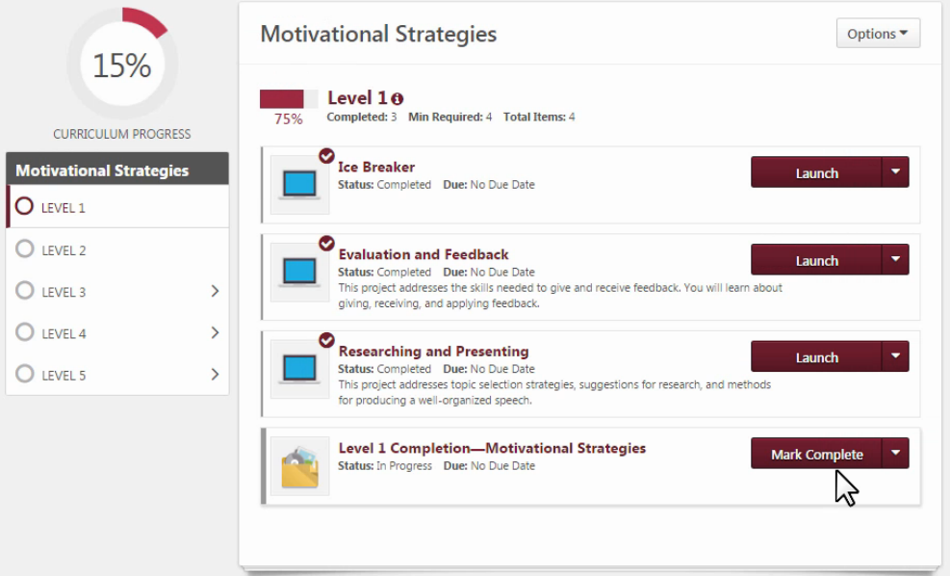
Mark Complete

Slide 35
Completing Projects, Levels
Member
  Complete a project
    Re-open project, complete Assess Skills-After
  Complete a level
    Run the “Level Completion” task
    Notify your VPE and base camp managers
    – Level completion must be approved to
    see details of projects in next level

Slide 36
Approval of Level Completion
Base Camp Manager (VPE, Pres or Secy)
  Mark the member’s level as Approved
Note: Members can now proceed with any project from any level but Basecamp Manager can approve completion only sequentially from Level 1 to Level 2 and then 3 and so on.

Slide 37
Notes:
Once all five levels have been completed and approved by Basecamp manager, then member can proceed to mark Path Completion.

Slide 38
Thank you!
For further information, contact:
D41pqd.23.24@gmail.com

