Slide 1
Pathways Introduction
Overview – Paths and Projects – Achievements and Awards
Notes:
Welcome to the Toastmasters Pathways learning experience, an exciting, flexible and interactive way to develop your skills and help others in your club develop theirs. Pathways helps you learn communication and leadership skills that you need to succeed.

Slide 2
Pathways gives you
Up to build up to 300 unique competencies
11 specialized learning paths
Online content
Real-world, transferable skills
Arabic, English, French, German, Japanese, Portuguese, Simplified Chinese, Spanish, and Traditional Chinese, with select paths available in Korean and Tamil
Notes:
Pathways gives you
The opportunity to build up to 300 unique competencies
11 specialized learning paths to choose from
Online content, so that you can learn anytime, anywhere
Real-world, transferable skills
Content available in Arabic, English, French, German, Japanese, Portuguese, Simplified Chinese, Spanish, and Traditional Chinese, with select paths available in Korean and Tamil

Slide 3
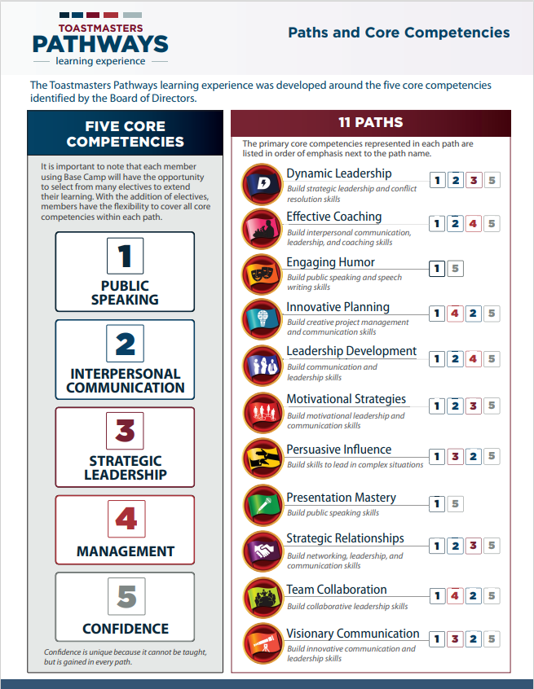
11 Paths

Slide 4
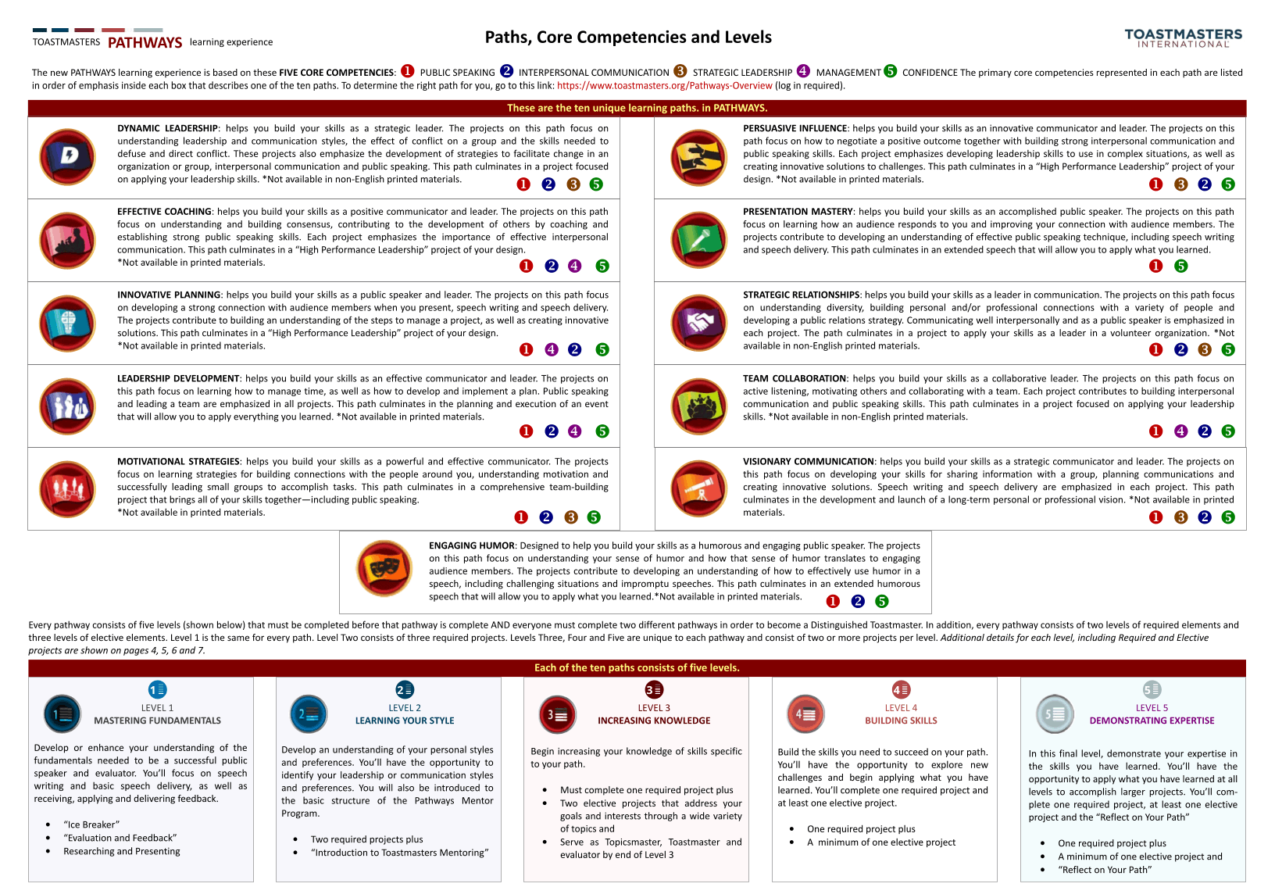
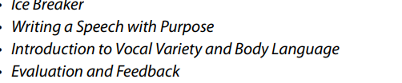
Notes:
Levels: Each path has five levels in which you complete projects and build on what you learned in the previous level.
Level 1: Mastering Fundamentals
Level 2: Learning Your Style
Level 3: Increasing Knowledge
Level 4: Building Skills
Level 5: Demonstrating Expertise

Slide 5
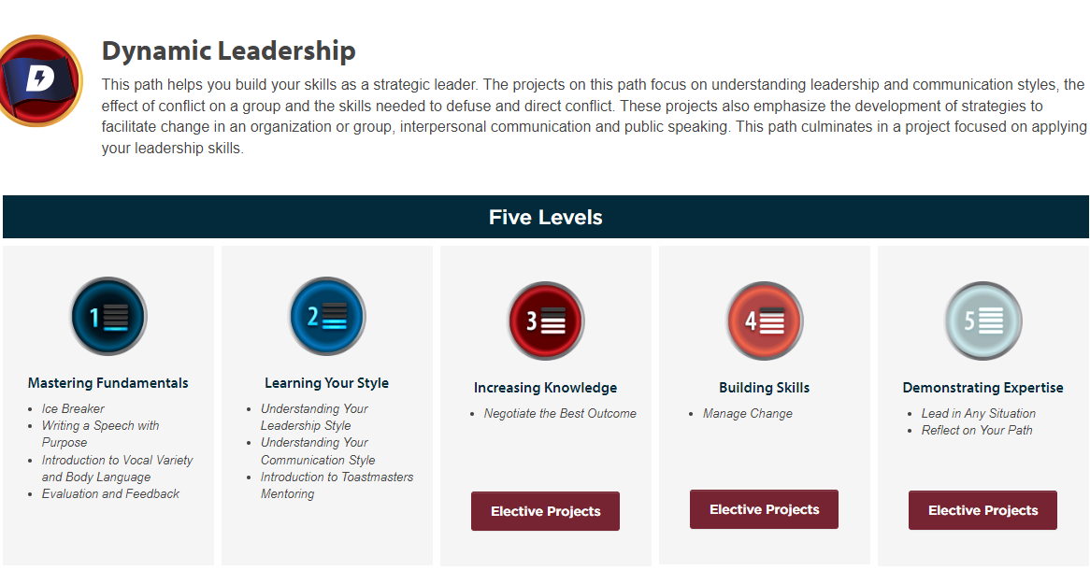
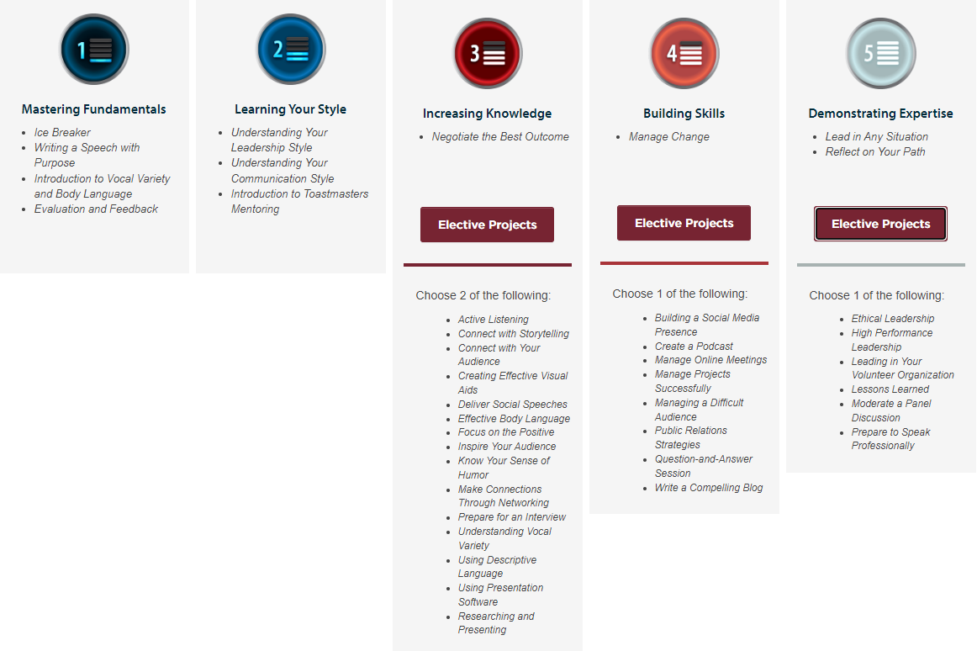
Path – levels and projects

Slide 6
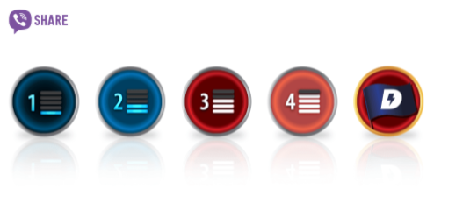
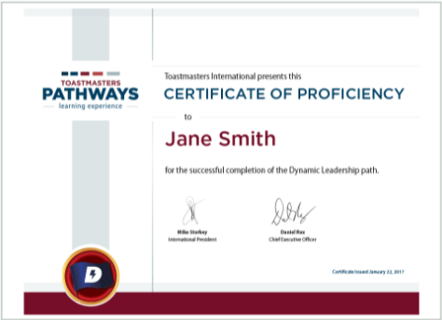
Achievement
Badges
Certificates
Employer letters
An email from the International President
Path completion
Pathways Mentor Program
Notes:
Badges
Earn digital badges on Base Camp to show fellow club members all you’ve done. Receive a path badge when you finish a path. Every time you complete a level, you’ll receive level badges signifying your achievement. You can also award feedback badges to recognize members of your club.
Certificates
Receive digital certificates whenever you reach important milestones in Pathways. To celebrate your accomplishments when you finish a level or complete a path, you can download or print a certificate directly from Base Camp.
Employer letters
Let your employer know about your achievements with official letters sent from Toastmasters. This is a great way to show them the commitment you’ve made toward personal growth. Employer letters can be requested when you complete Level 3, Level 4 or Level 5 in a path.
An email from the International President
Enjoy a celebratory email from the International President congratulating you on your success when you complete a path. You may also request a printed version of this commemorative message from World Headquarters.
Path completion
Proudly receive the accolade of Proficient for each path you complete. For example: “Toastmaster Sara completed the Motivational Strategies learning path and is now Motivational Strategies Proficient.”
Pathways Mentor Program
Have you ever wanted to be a mentor? The Pathways Mentor Program gives you the opportunity to help others by building and reinforcing the skills needed to provide effective mentoring. Complete this program and become a credentialed mentor once you are Proficient in a path.

Slide 7
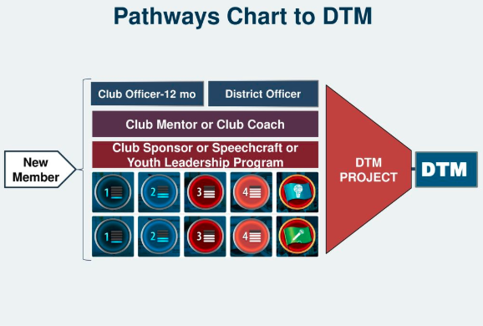
Awards - Distinguished Toastmasters
Notes:
Distinguished Toastmaster
Complete two learning paths.
Serve as a club officer for two six–month terms or one annual term, participate in the preparation of a Club Success Plan, and participate in a District-sponsored Club Officer Training.
Serve a complete one-year term as a District leader.
Serve successfully as a club mentor or coach.
Serve successfully as a club sponsor or conduct a Speechcraft or Youth Leadership program.
Complete the DTM project. (Members are required to create and implement a project of their own design, in which they demonstrate the skills and expertise they have gained.) Members can receive access to the DTM project on Base Camp once they have completed one path and Levels 1, 2, and 3 in a second, unique path. To receive this project, email educationprogram@toastmasters.org.

Slide 8
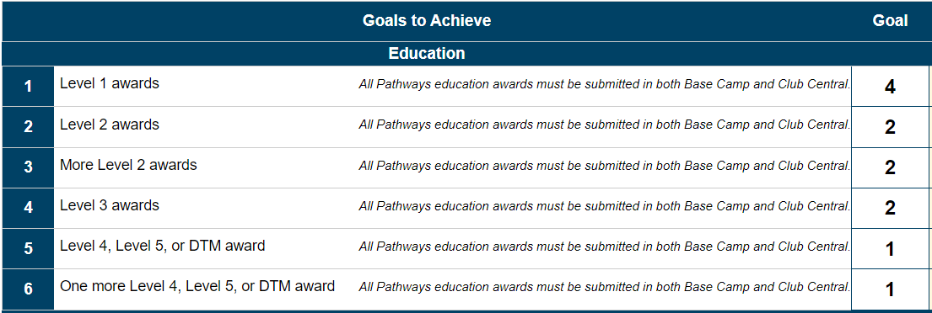
Awards - Distinguished Club Program
Notes:
Distinguished Club Program
The Distinguished Club Program (DCP) is an annual award program recognizing clubs that provide an outstanding member experience. You play a vital role in your club’s participation in the DCP through your achievements. There are six educational DCP goals you and members of your club can fulfill:
Four Level 1 awards achieved
Two Level 2 awards achieved
Two more Level 2 awards achieved
Two Level 3 awards achieved
One Level 4, Path Completion, or DTM award achieved
One more Level 4, Path Completion, or DTM award achieved
Contact your vice president education for more information on the DCP.

Slide 9
Thank you!
For further information, contact:
D41pqd.23.24@gmail.com

