Slide 1
Pathways – Select Your Preference
Choose a Path
Notes:
Welcome to the Toastmasters Pathways learning experience, an exciting, flexible and interactive way to develop your skills and help others in your club develop theirs. Pathways helps you learn communication and leadership skills that you need to succeed.

Slide 2
Enter Pathways
Take the assessment
Select a path

Slide 3
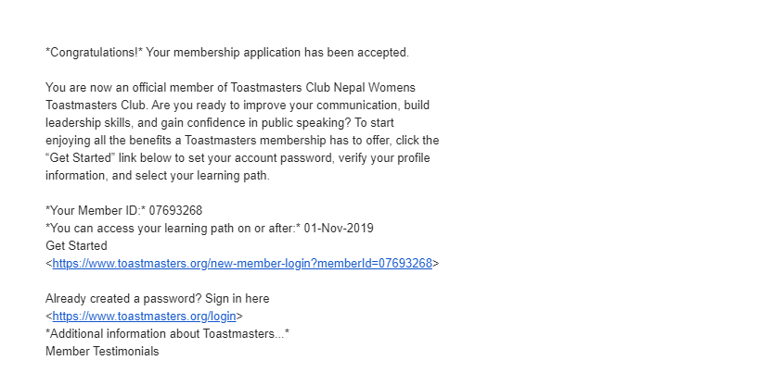
Email from Toastmasters

Slide 4
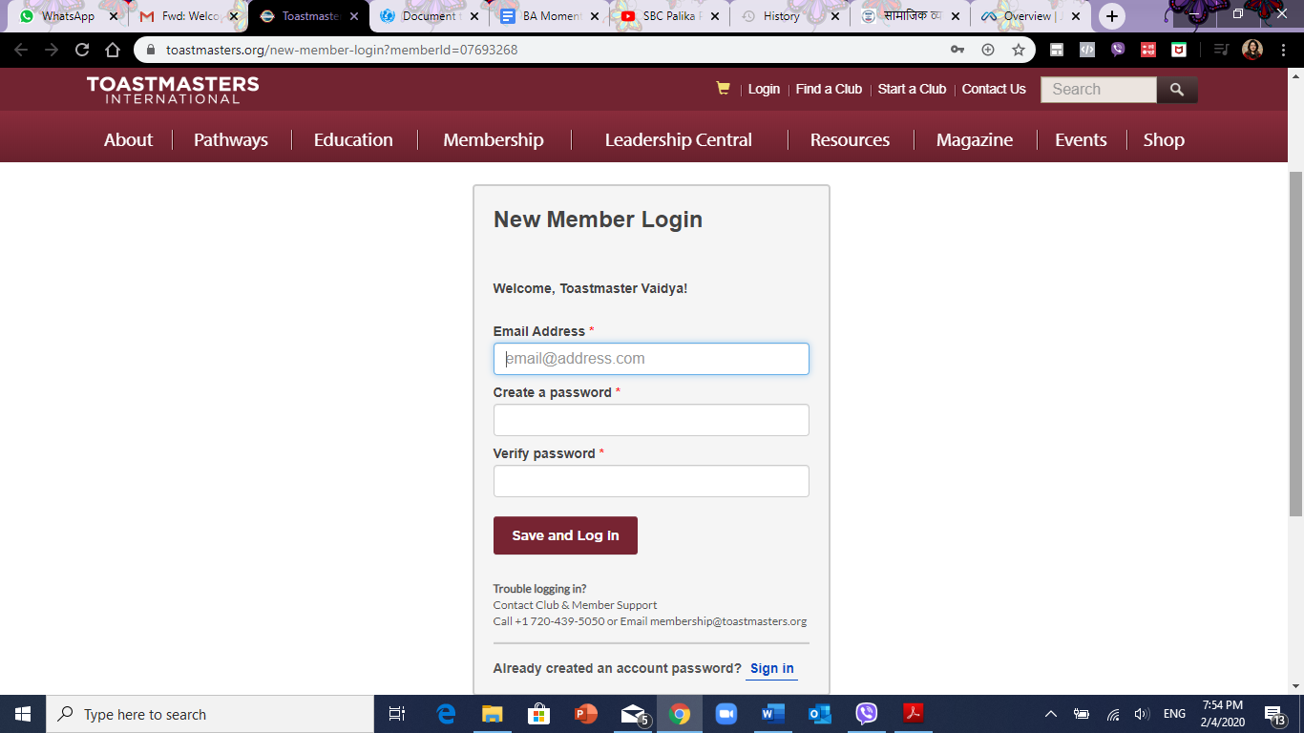
Set your password!

Slide 5
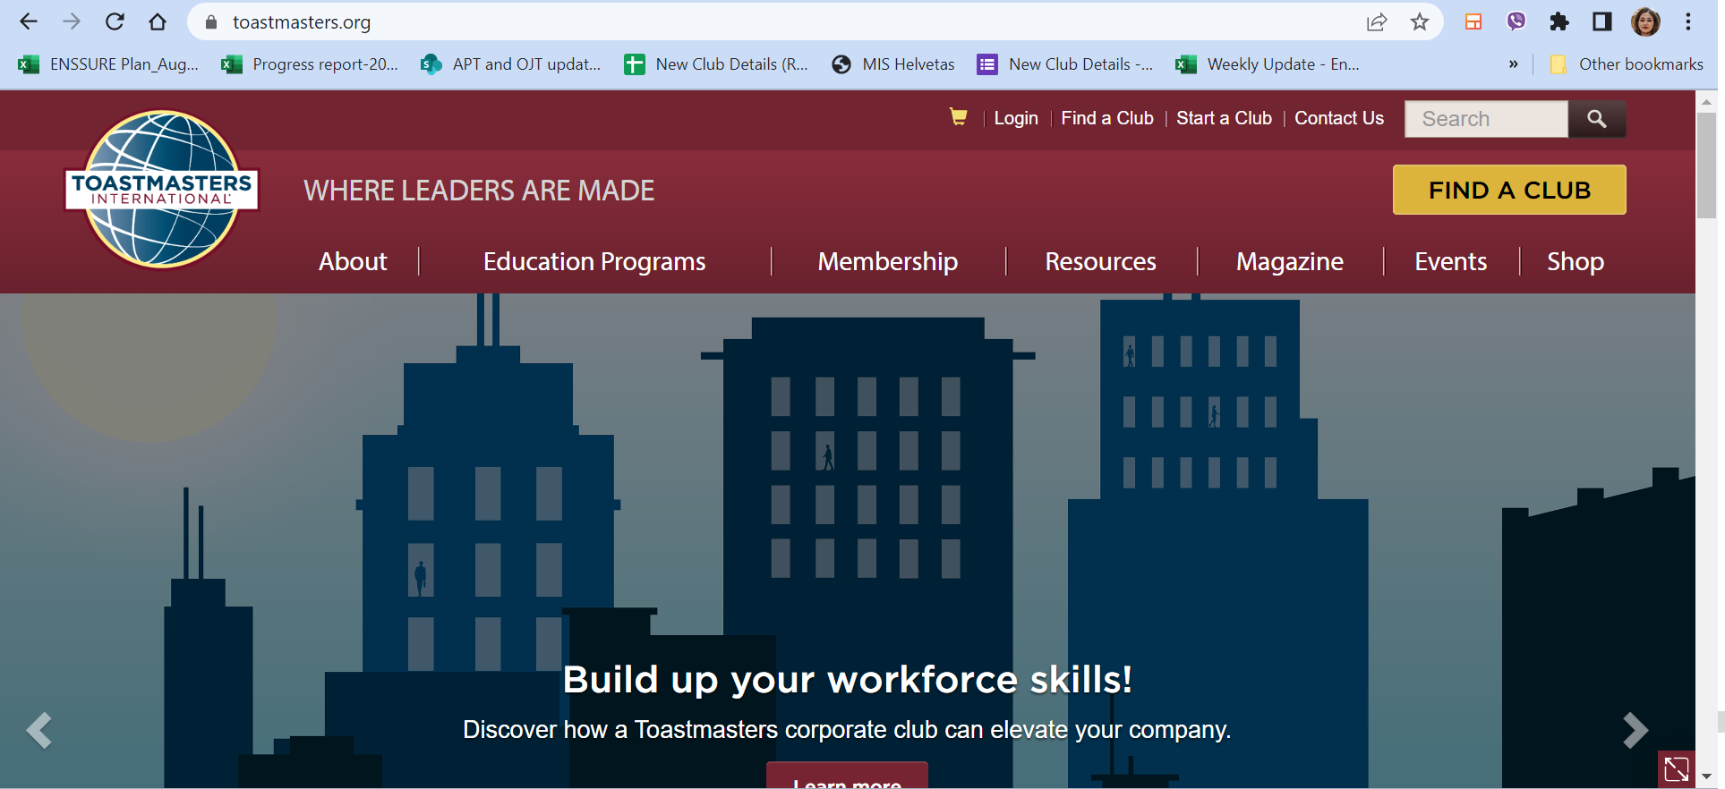
Go to www.toastmasters.org

Slide 6
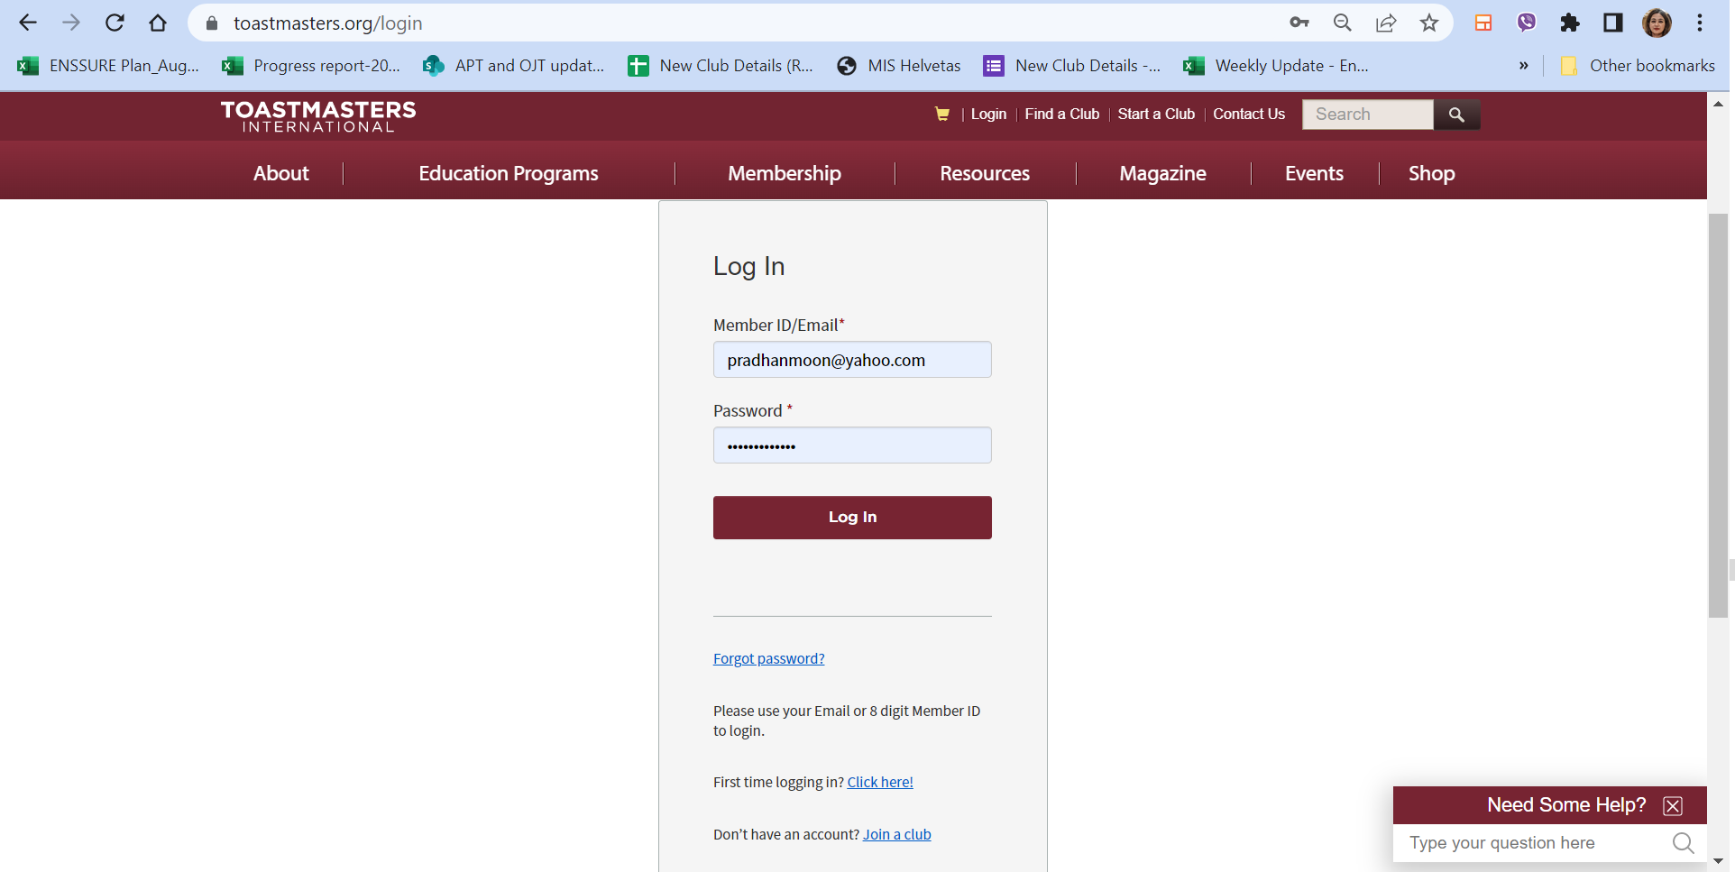
Log in
Enter the password that Toastmasters has emailed you.
If this is the first time that you are logging into the website then leave this blank. And click the Forgot password?
You will receive an email with password. Use that after you receive it.
Enter the email address that is registered with Toastmasters International

Slide 7
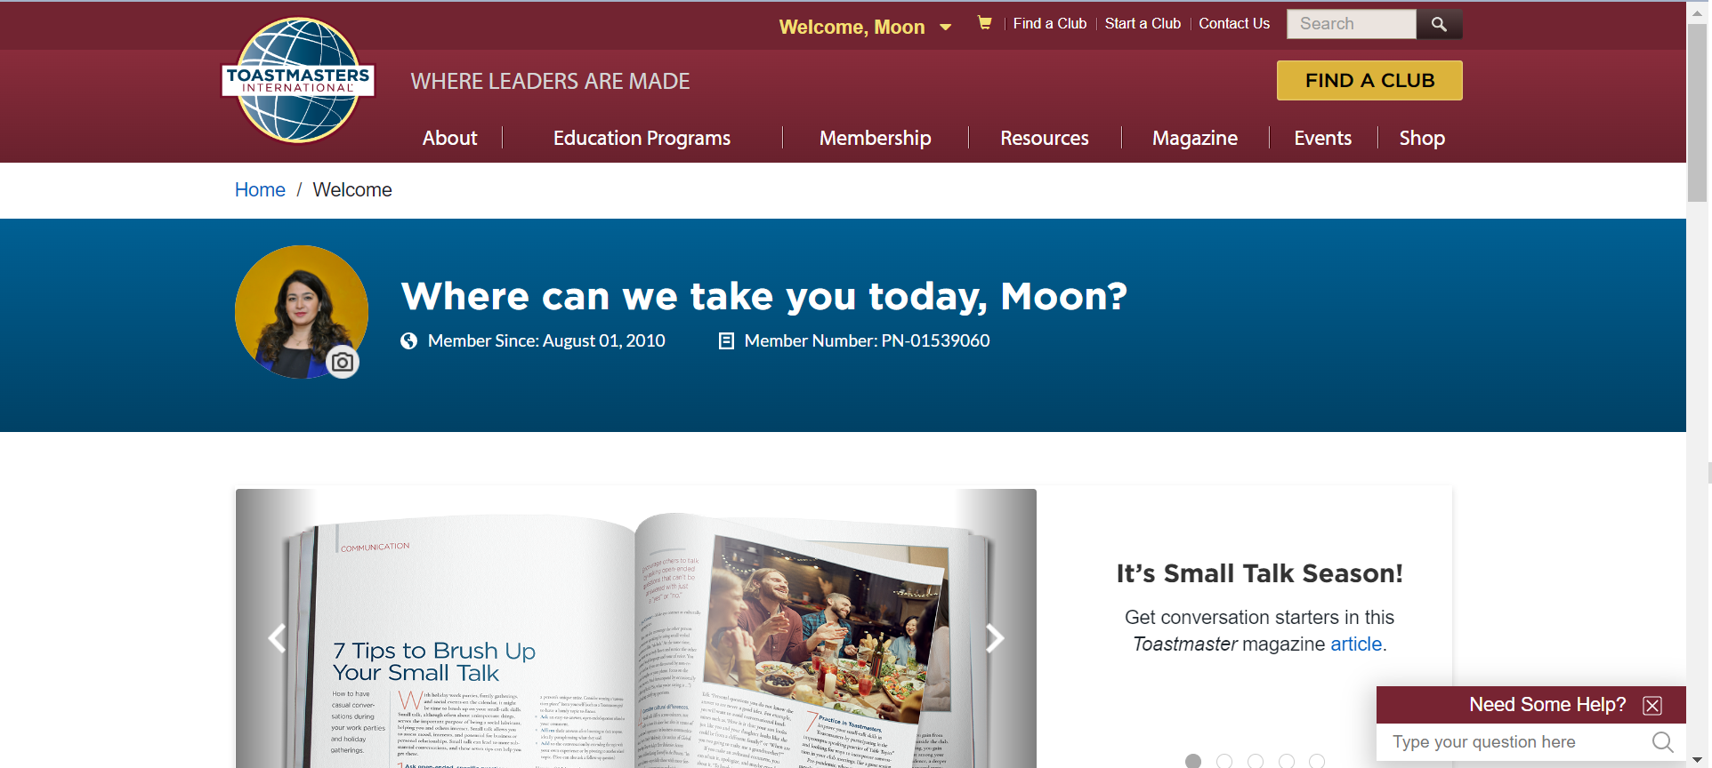
Go to Pathways

Slide 8
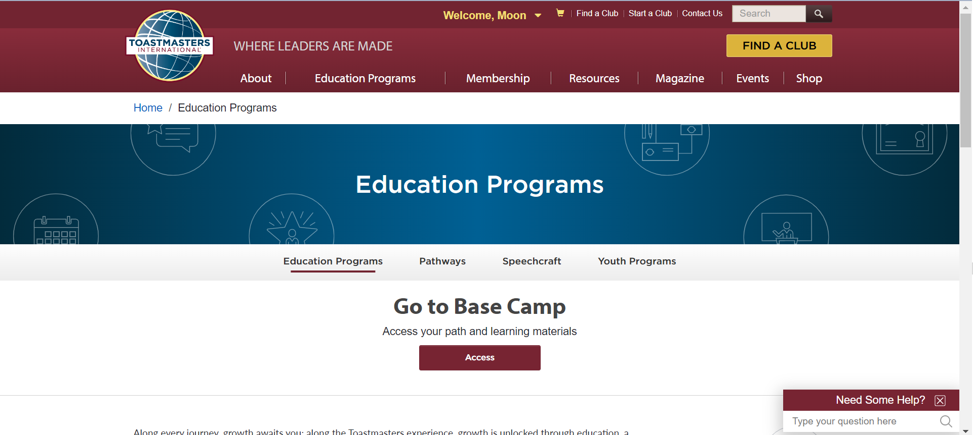
Go to Pathways

Slide 9
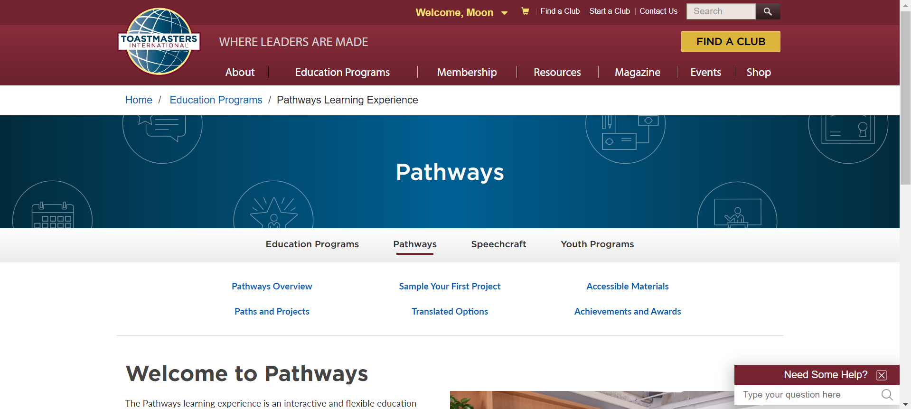
Pathways

Slide 10
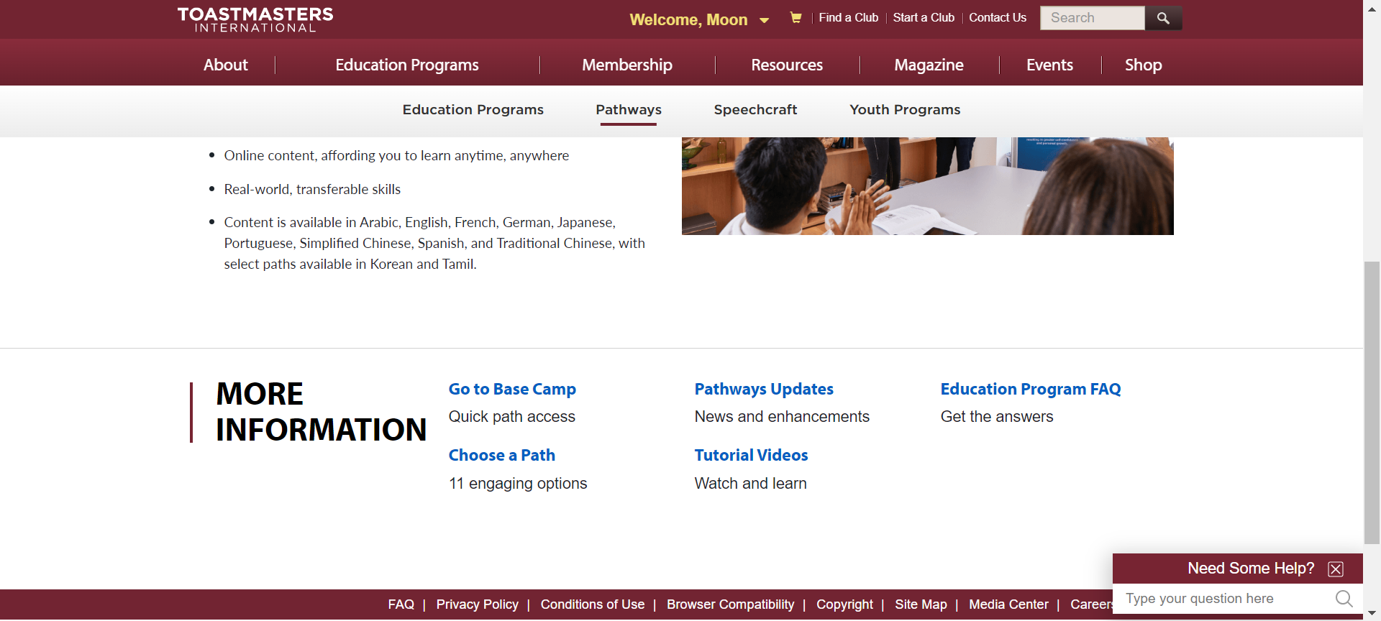
Choose a Path

Slide 11
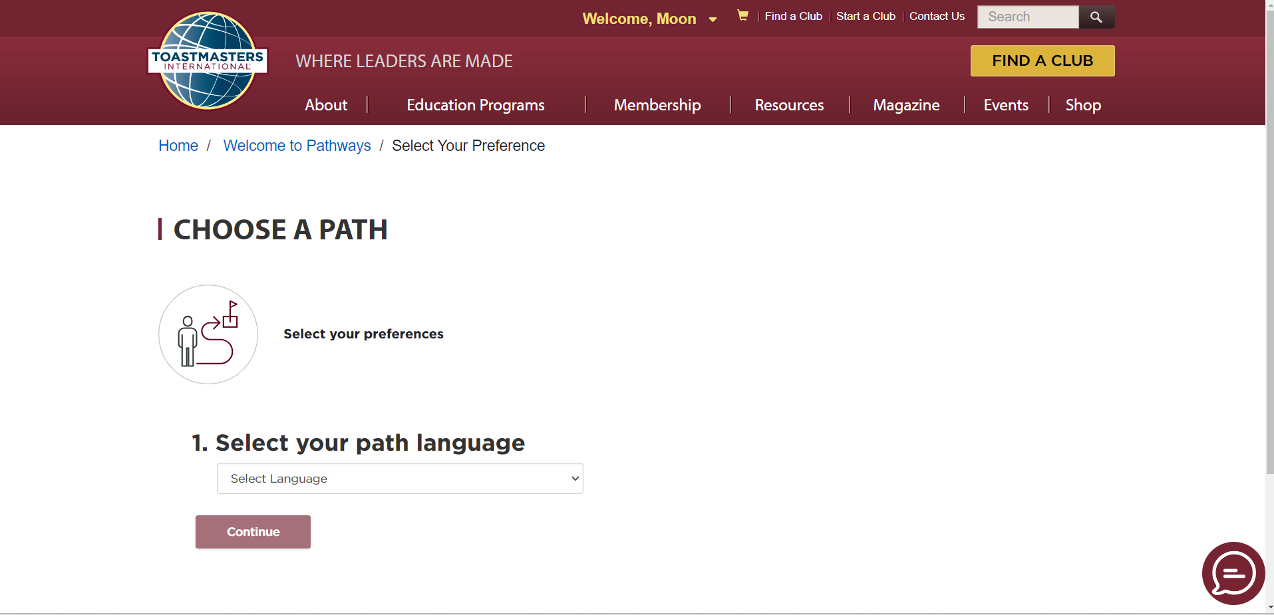
Select Your Path Language

Slide 12
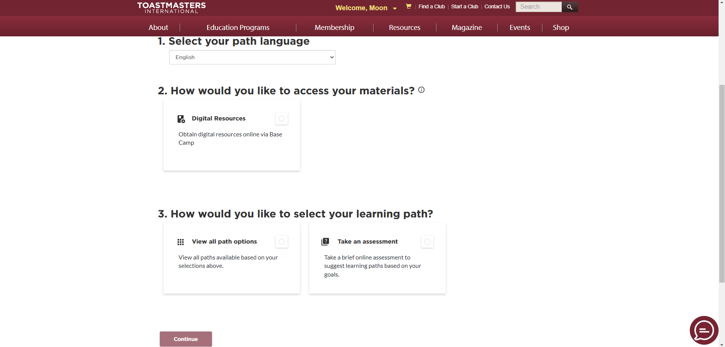
Digital Resources
Notes:
Print resources have been discontinued from July 2023. If you are not able to access digital resources, then you should contact Toastmasters Headquarters.

Slide 13
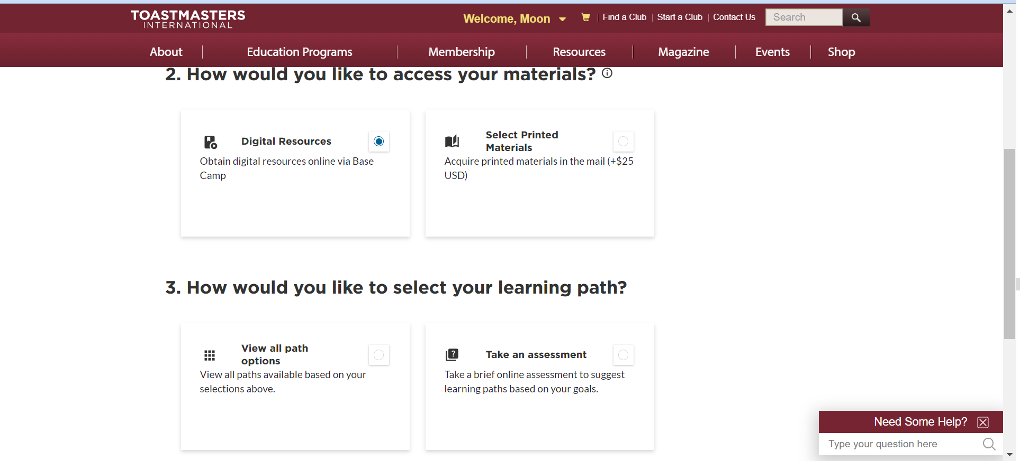
View All Paths

Slide 14
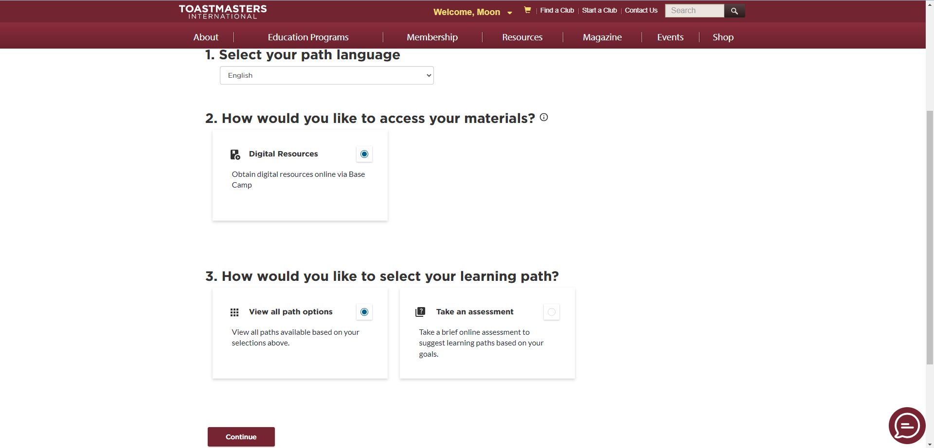
Continue

Slide 15
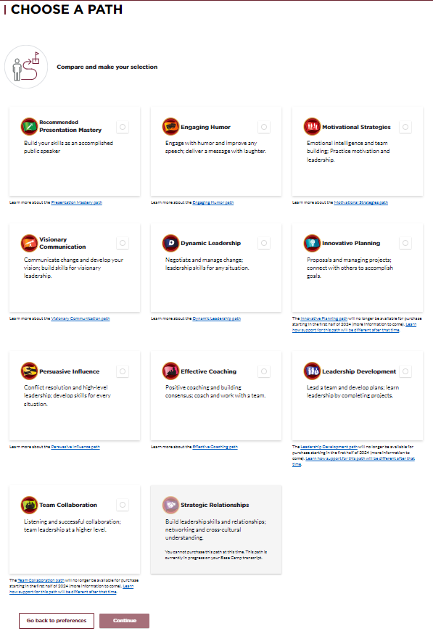
Choose a Path

Slide 16
Continue

Slide 17
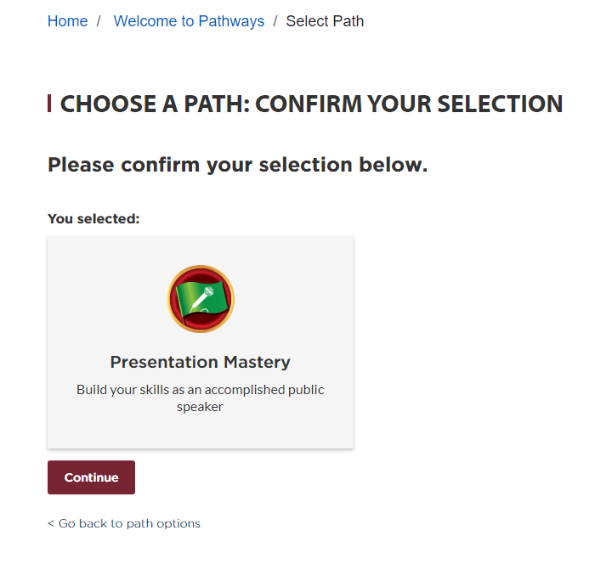
Confirm Your Selection

Slide 19
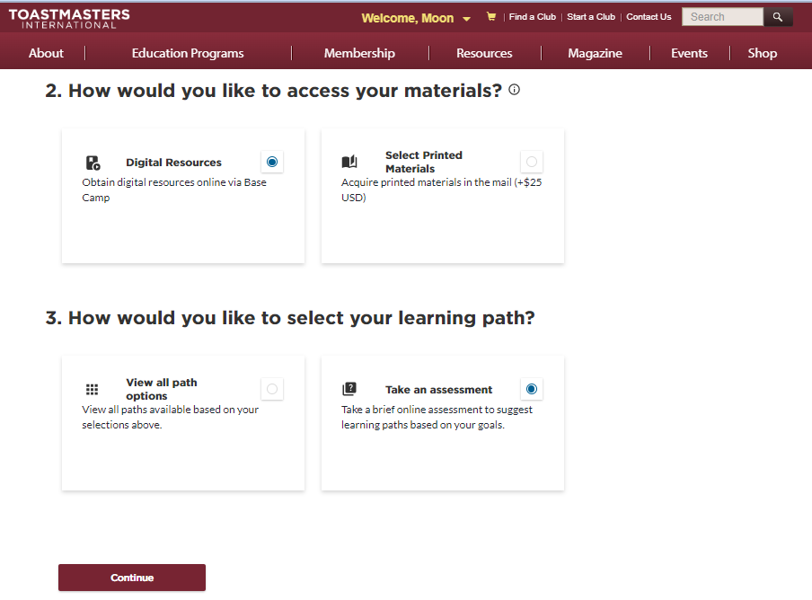

Slide 20
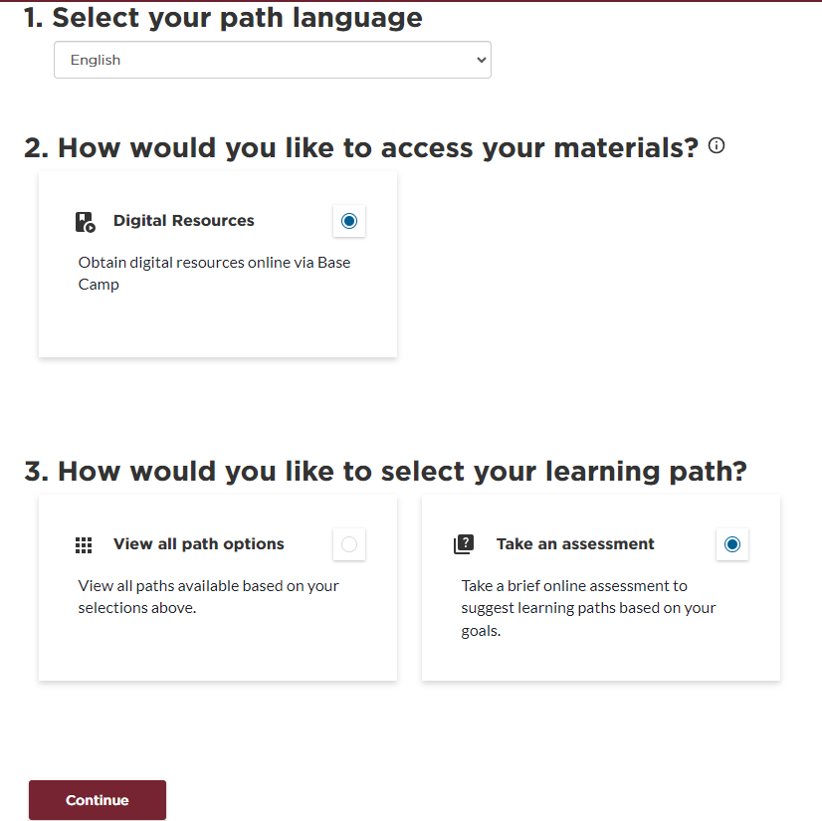
Alternative - Take an Assessment

Slide 21
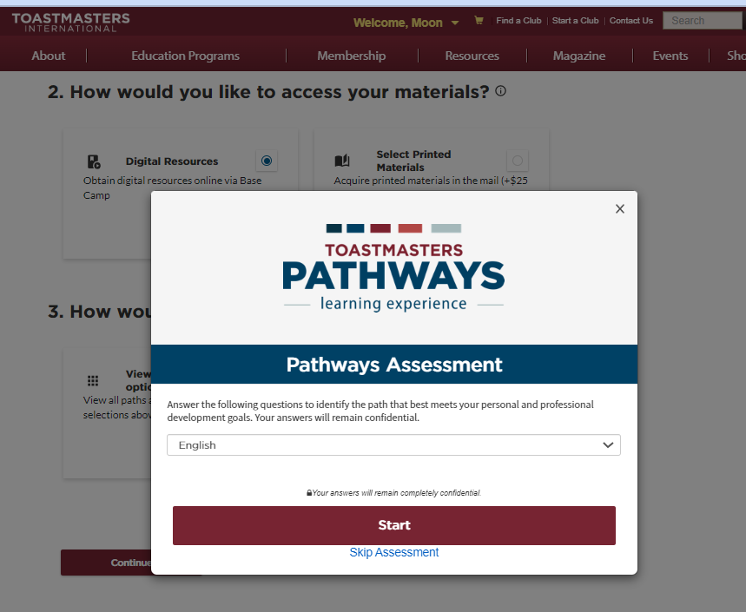

Slide 22
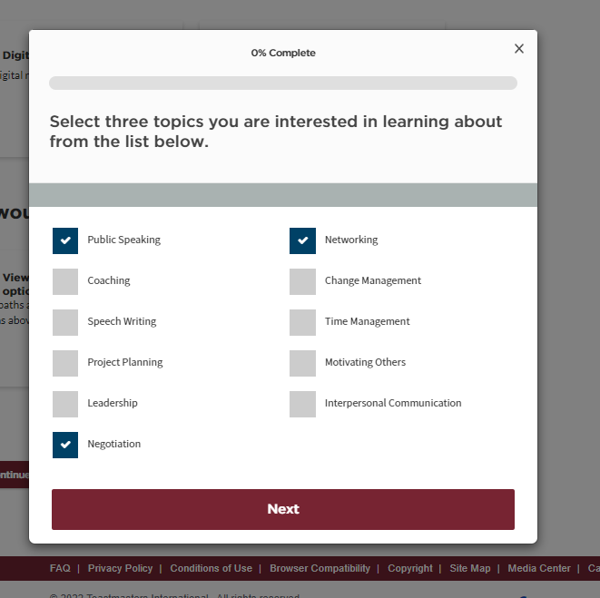

Slide 23
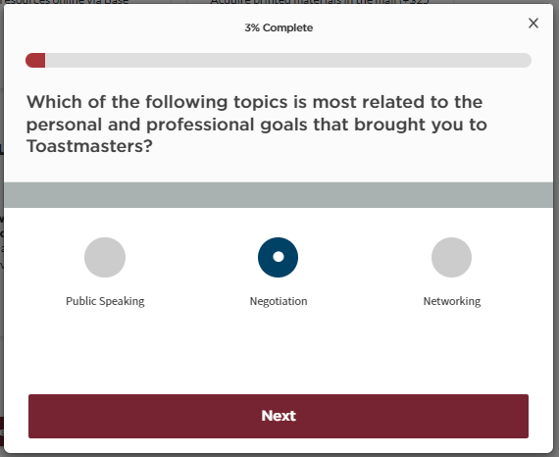

Slide 24
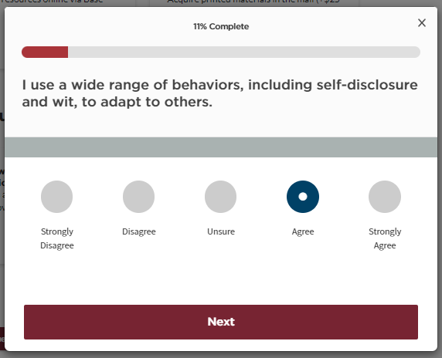
Notes:
Total 25 questions

Slide 25
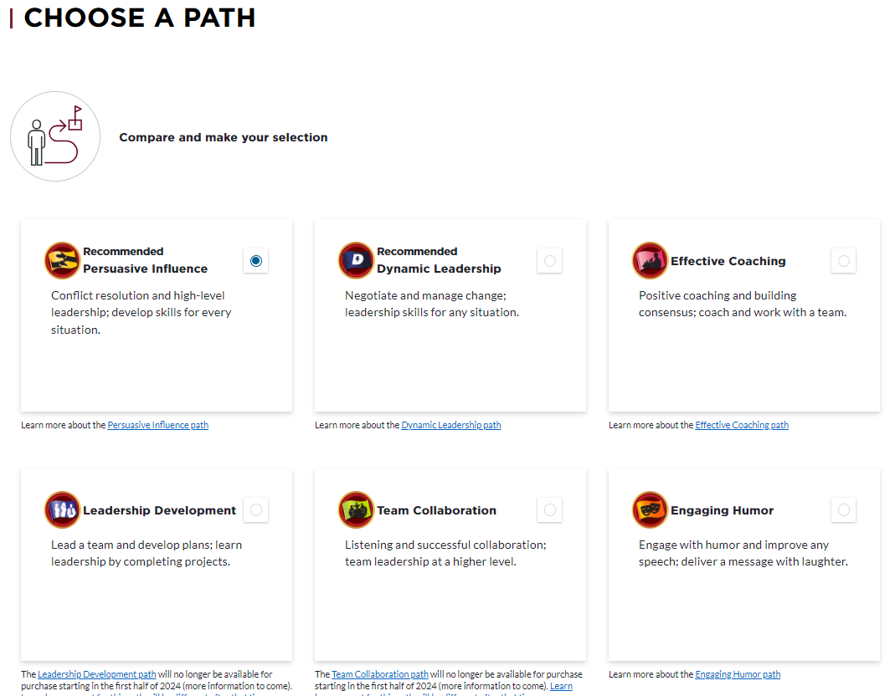

Slide 26
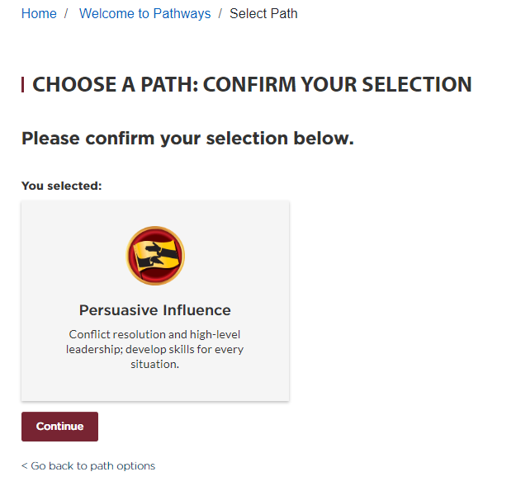
Confirm Your Selection

Slide 27
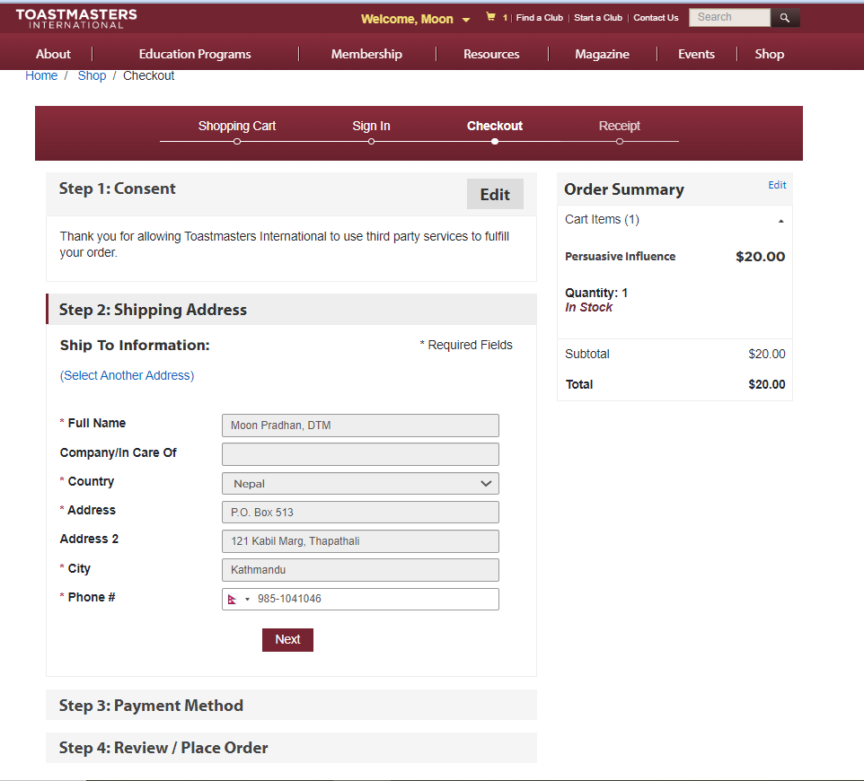
First path will be $0.00

Slide 28
Thank you!
For further information, contact:
D41pqd.23.24@gmail.com

